Slide 1

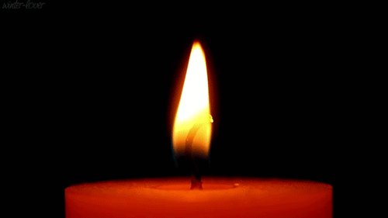
KS
Collective Worship
Parliament Week

Slide 2
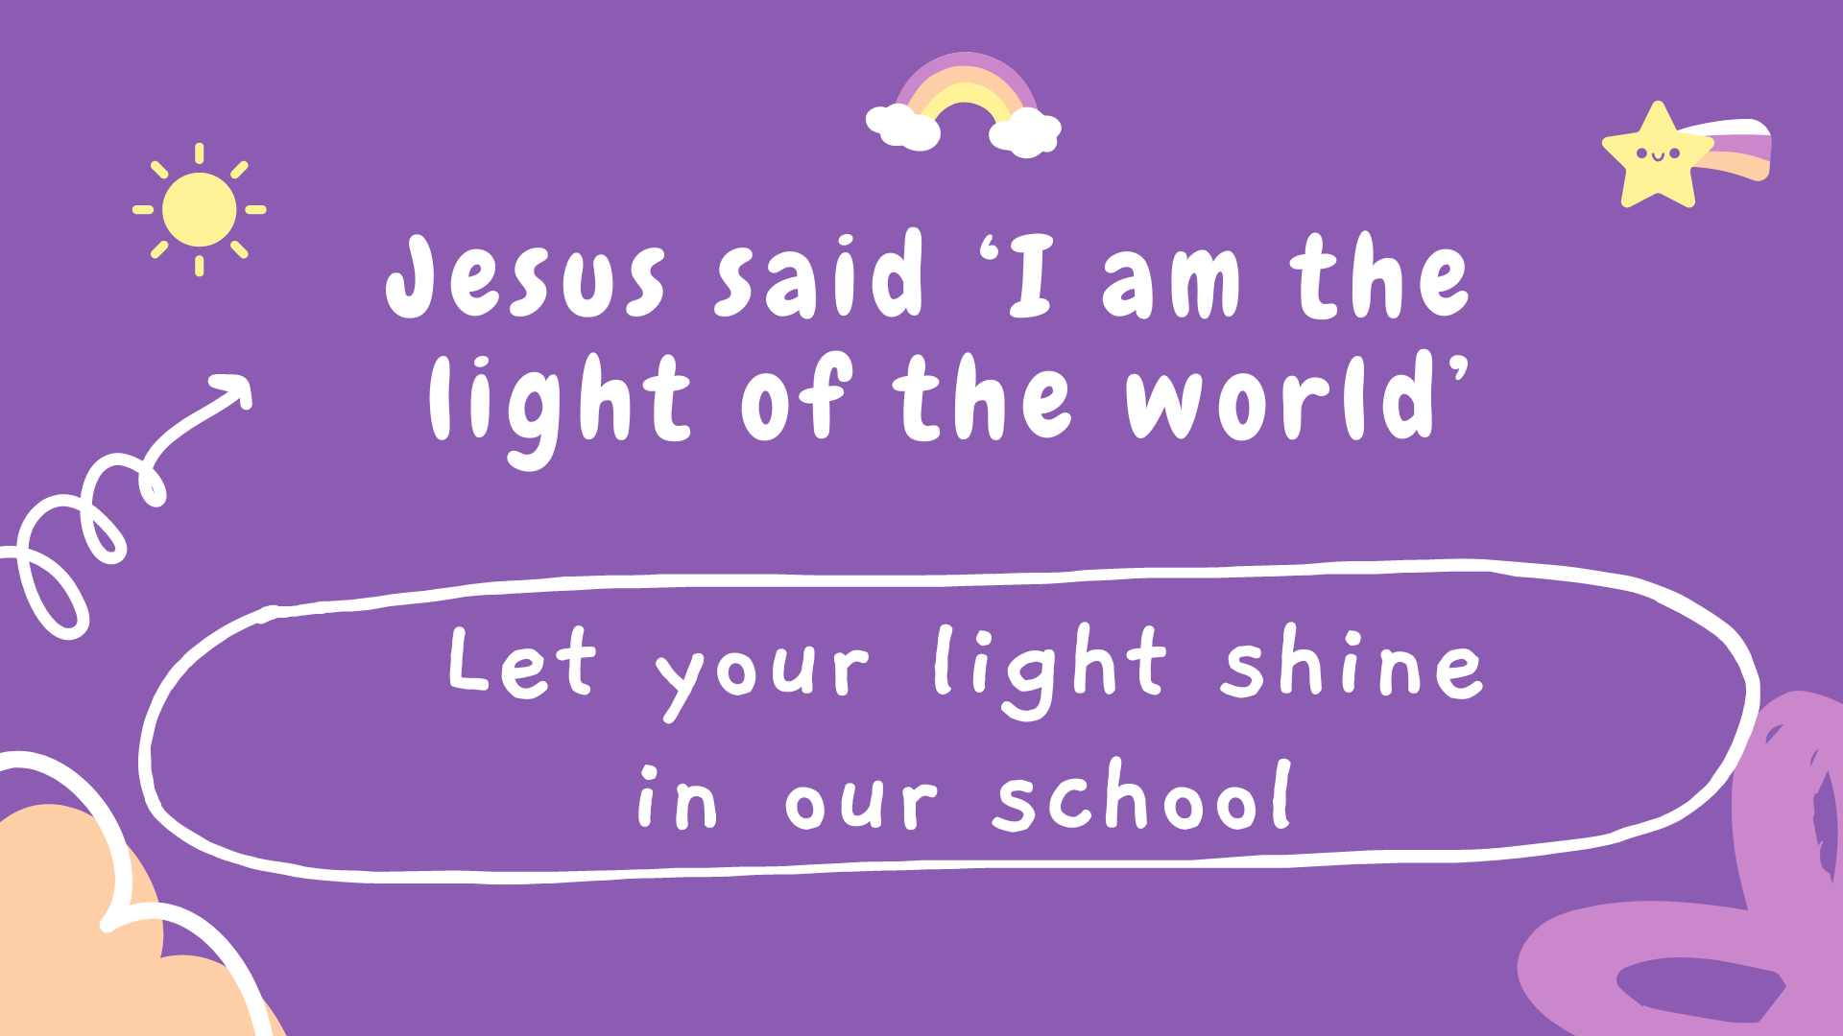

Slide 3
Parliament Week
Welcome to Parliament Week at Bramley St. Peter’s!
At school, we have a team led by Mrs Esplin.
Members of Parliament and local council leaders represent our country and our city.
These MP’s and councillors are elected democratically. Democracy is where we all get to have a voice – whether we are children or adults.
In this Parliament week we want to focus on the part WE play in democracy and hear about our very important visitor Rachel Reeves.

Slide 4

Who is who…
Our councillors are Tom Hinchcliffe, Kevin Ritchie and Adele Rae.
Our local MP is called Rachel Reeves and she is also the Chancellor of the Exchequer in Government. This means she looks after all of the country’s money.
We would like to tell you about when Rachel Reeves came to visit.

Slide 5
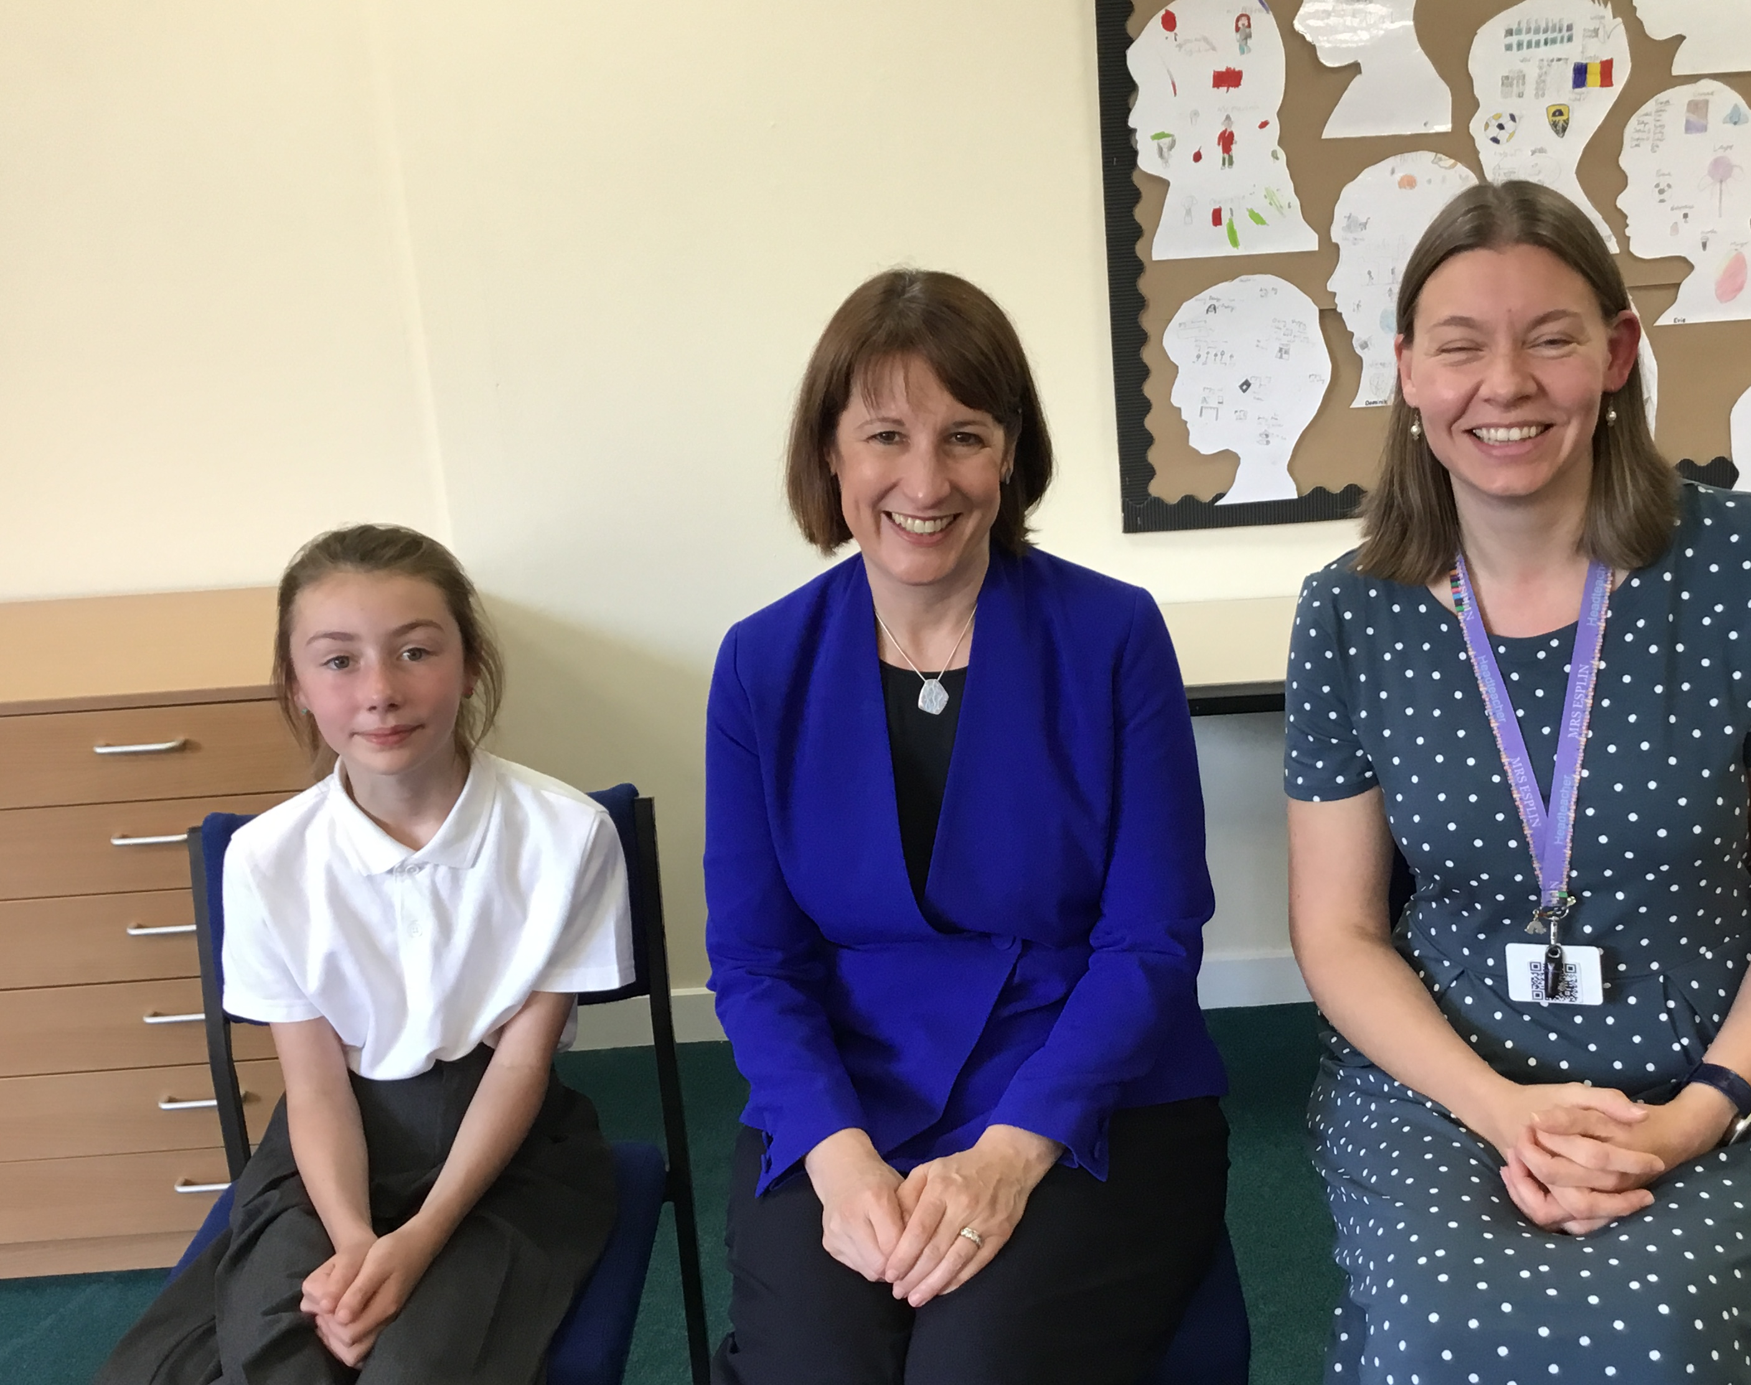
This is Rachel on her visit to our school with Mrs Esplin and Ember-Rose, who had applied to be Leeds Children’s Mayor.

Slide 6
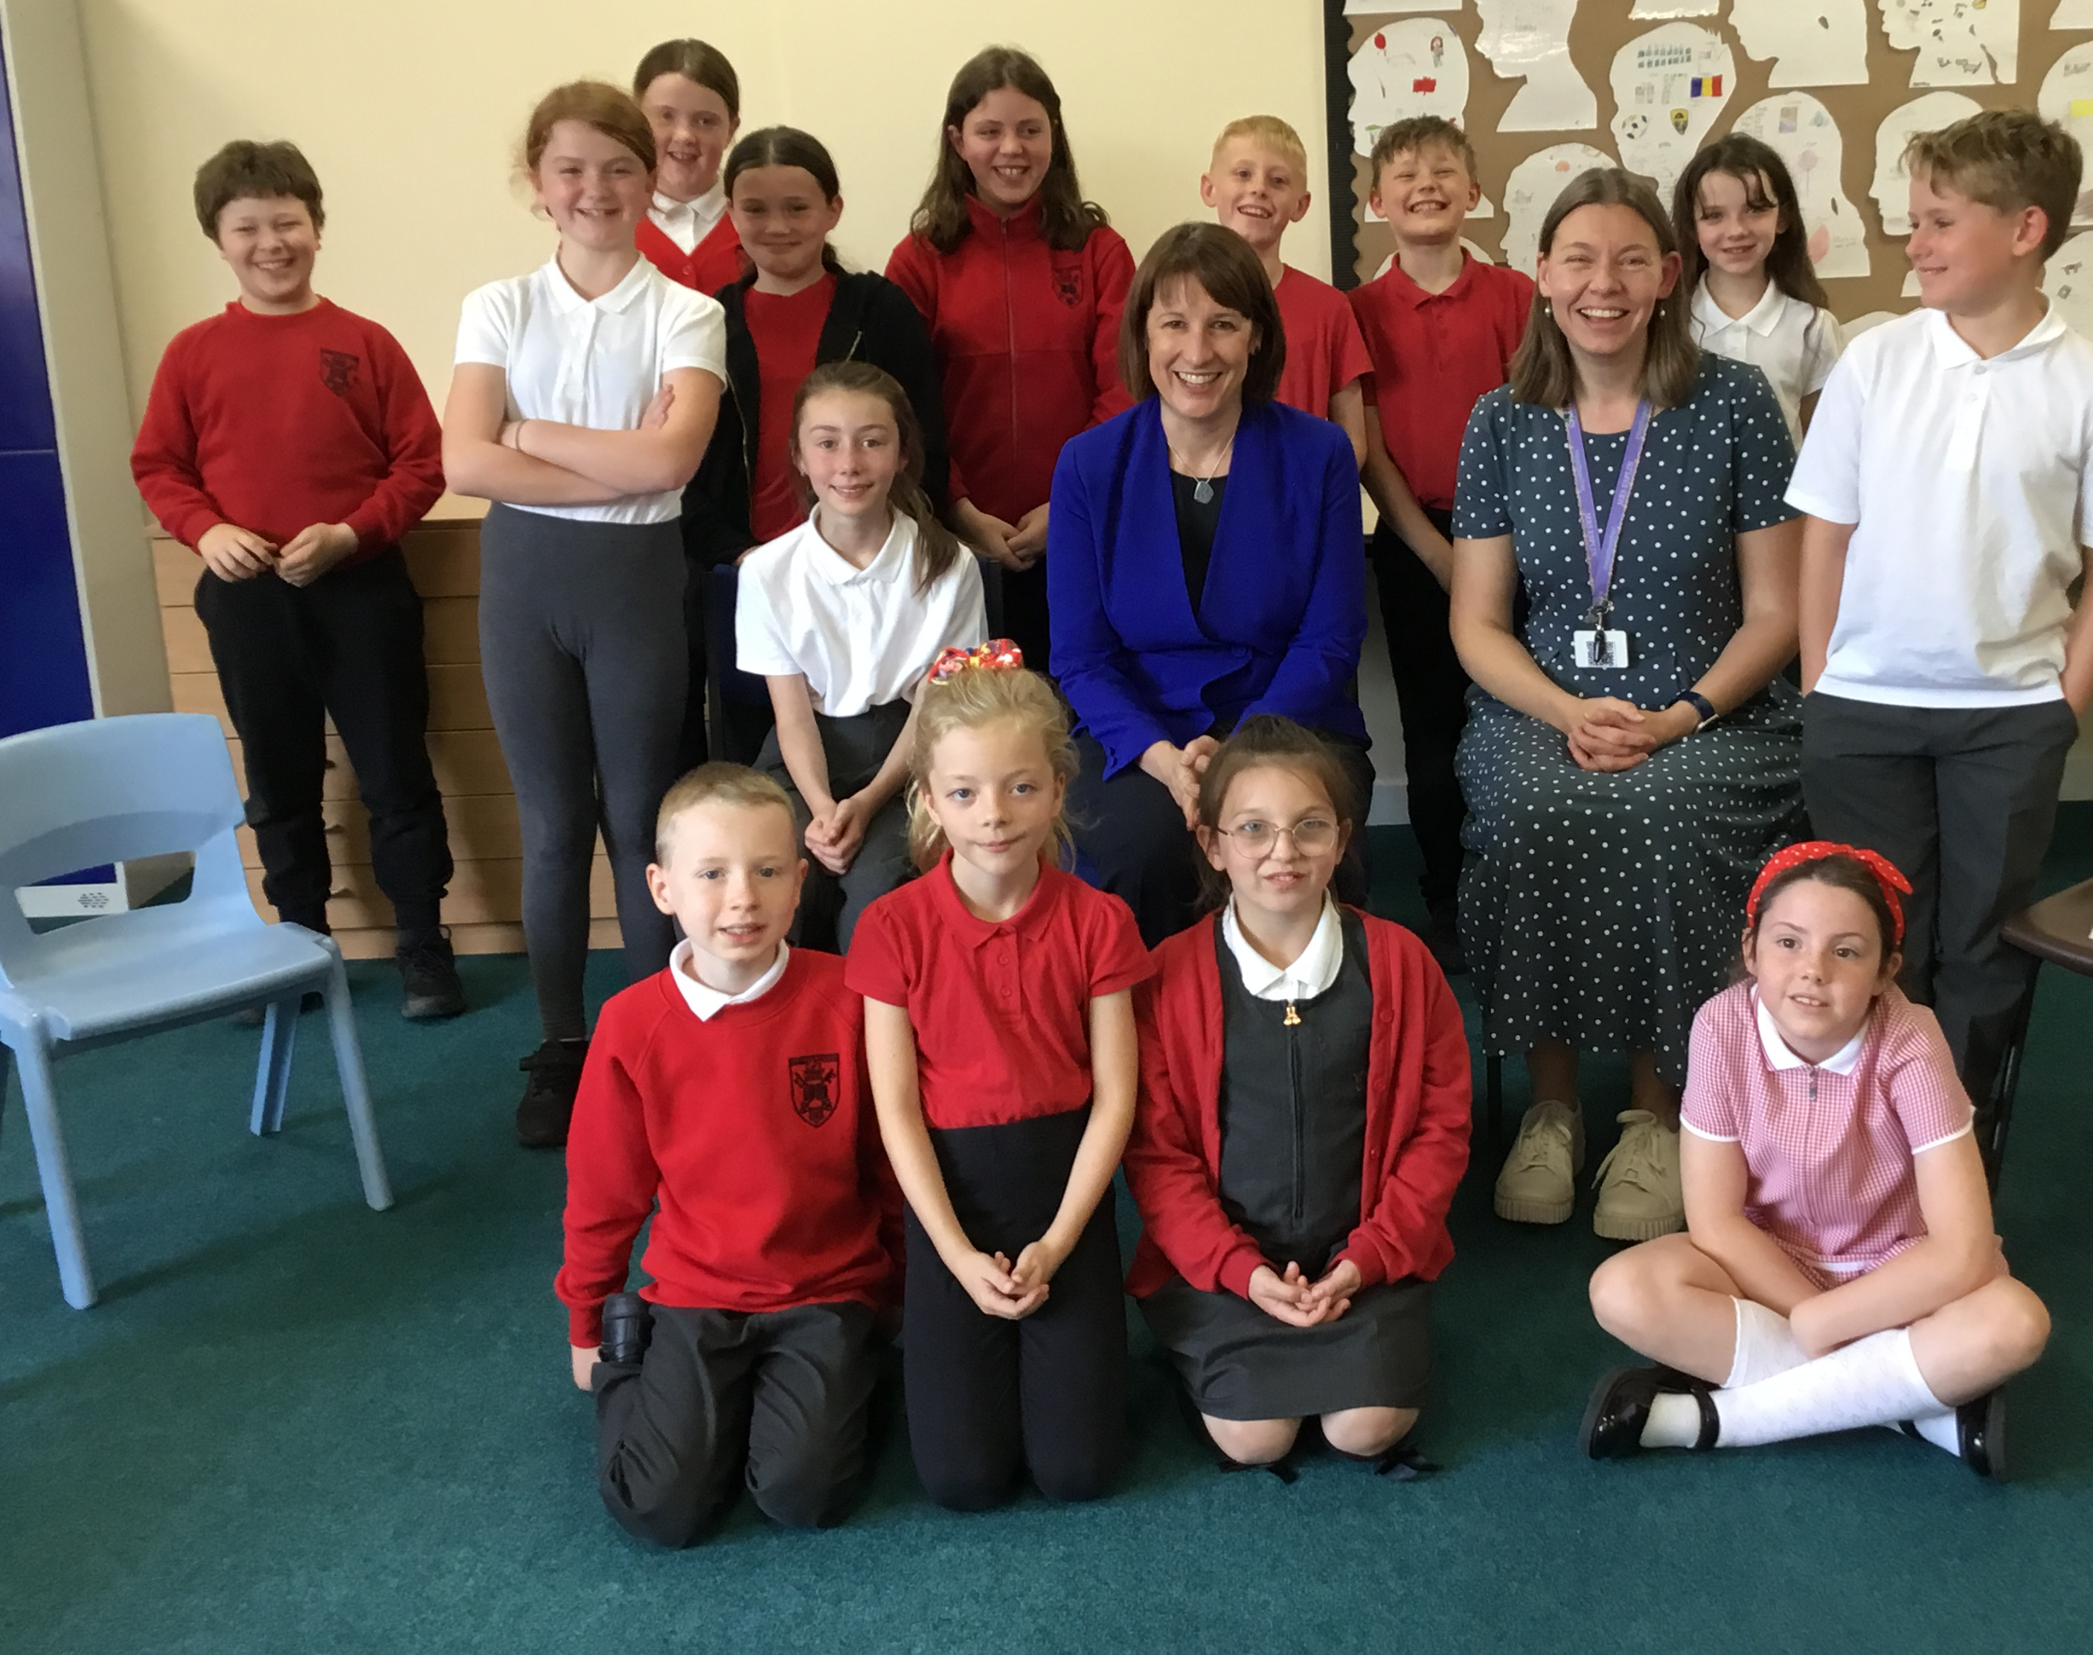
This is Rachel meeting with our ‘old’ school councillors

Slide 7

We asked Rachel lots of questions about her job as our MP and also her job in Government.
The big question we asked was how she was going to help children to learn in school – how would she make sure that there was enough money so that we can learn, enough money so that we have a safe school, with enough staff, enough books and pencils, and enough money so that we can go on trips and residentials so we can have fun in school and out of school. Rachel told us she would pass our questions on to the person in Government who looks after education. She did explain some of the ways she is using her voice to get more money to fund education.

Slide 8
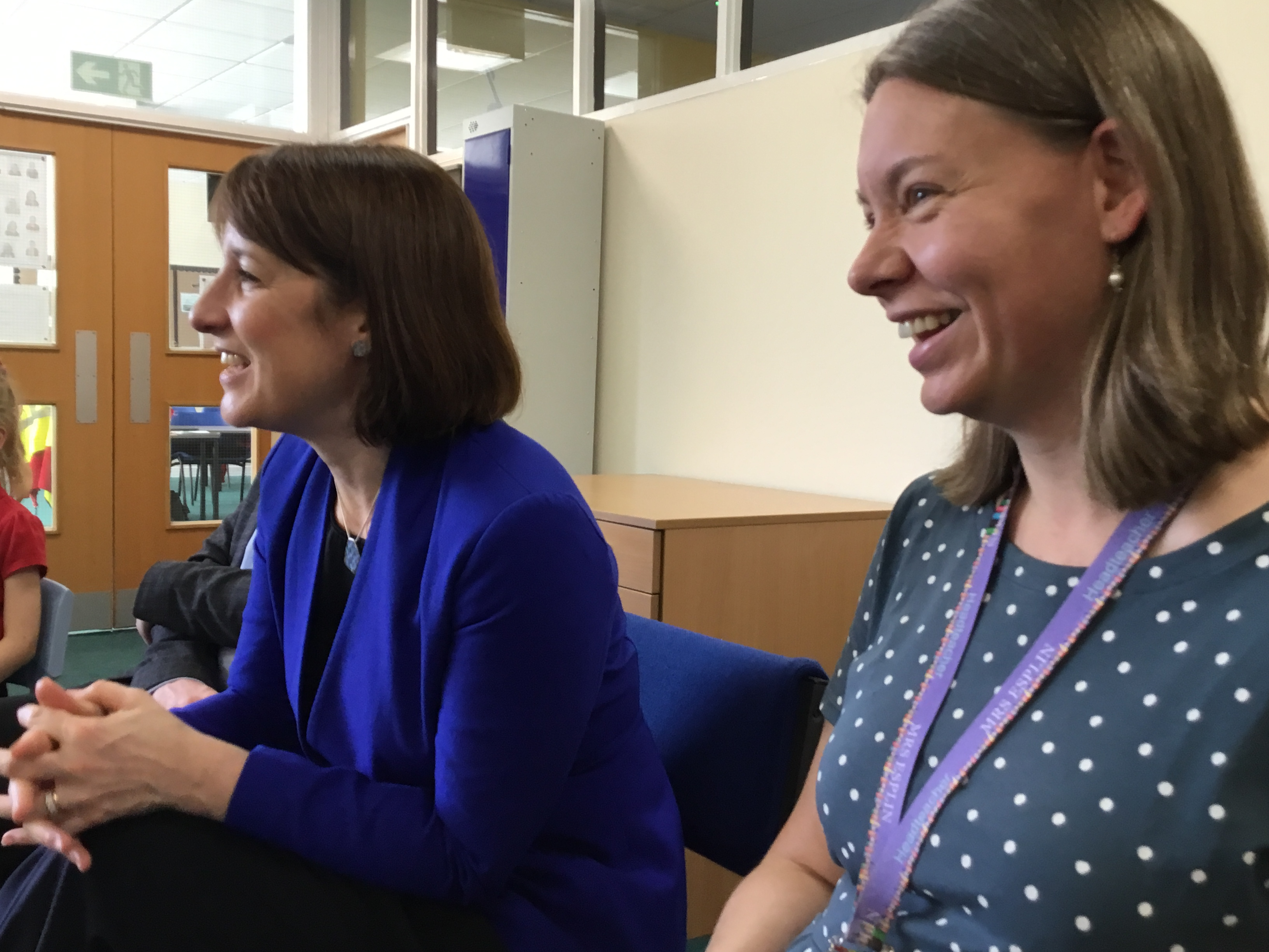
Rachel was very interested in our own School Council, and hearing about our campaign for a crossing outside school.

Slide 9
She listened as we told her about our Brightening Bramley campaign, planting flowers and bulbs outside school. She was very impressed.

Slide 10
The Summit
In a few weeks, we will be going to the Leeds Civic Hall, together with children from schools in Bramley, Kirkstall and Armley.
We will be learning all about democracy, meeting the Lord Mayor, and spending money.
The money we will be spending will be for activities which we would like to see in our area.

Slide 11
Our School Council Meeting
At our last school council meeting, we thought about all of the activities we would like to spend money on for our community, and we split them into 3 categories – sports and health, arts and crafts, and music and performing.

Slide 12
Sports and health
Our ideas included
Rugby
Gymnastics club
Fitness
Dodgeball
Swimming
Boxing
Handball
Football
Tennis

Slide 13
Arts and crafts
Our ideas included:
Wood carving
Graffiti
Origami
Modelling
Making bird boxes
Environment work
Painting
Drawing
Clay

Slide 14
Music and performing arts
Our ideas included:
Gardening
Cooking
Dance
Drama
Choir
Learning an instrument
Books and reading

Slide 15
Where do you come in?
We would like you to think about which area you would like us to tell the council how we would like to spend the money!
Would you like money for sports and health?
Money for arts and crafts?
Money for music and performing arts?
We would like you to vote for your favourite topic.

Slide 16
This is what your voting slip looks like. The vote ends at 12 noon on Friday 8th November.
(You can only vote for 1)
Activity | Put your X in one box below
Sports and health
Arts and crafts
Music and performing arts

Slide 17
Voting
We will be putting out ballot boxes around school for you to put your voting slip in. Please use your voice and vote!

Slide 18
Results of the vote
We will publish the results and put them up around school.
We will send the results to our local councillors so that they have heard our collaborative school voice.
We might not get the result we voted for, but we know that our votes, along with many others will be counted.
We will RESPECT the decisions of the council.

Slide 19
Reflection time
Please take a moment to reflect on what we have spoken about and think about how you could make a change in your community, how important it is to be respectful that others might not have the same opinion as you, and how important it is to be heard in a democracy.

Slide 20
Let us Pray
Dear God, please look after and guide all of the leaders in our country, our community and in our school.
Please give them wisdom to help them to make the right decisions for us all.
Please look after and guide all the people in our school and help us to make the right choices always.
In Jesus’ name,
Amen

Slide 21


