Slide 1


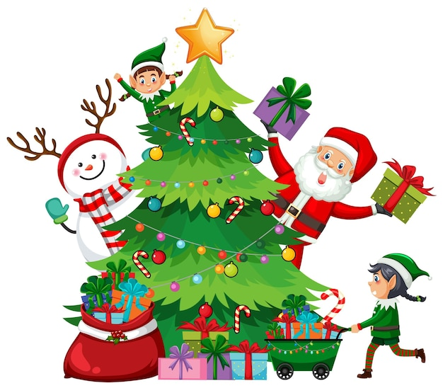






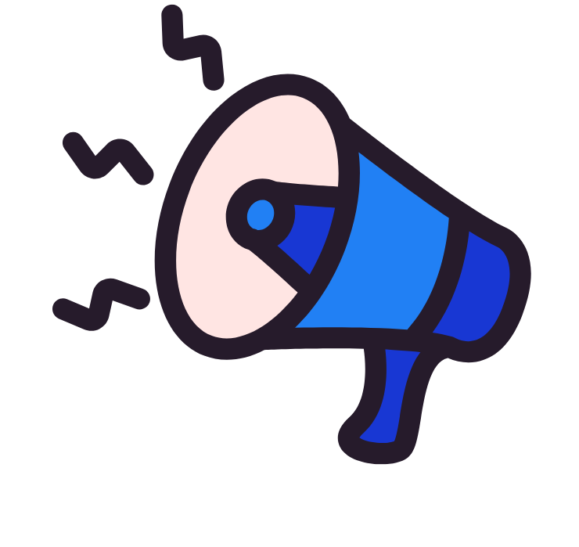




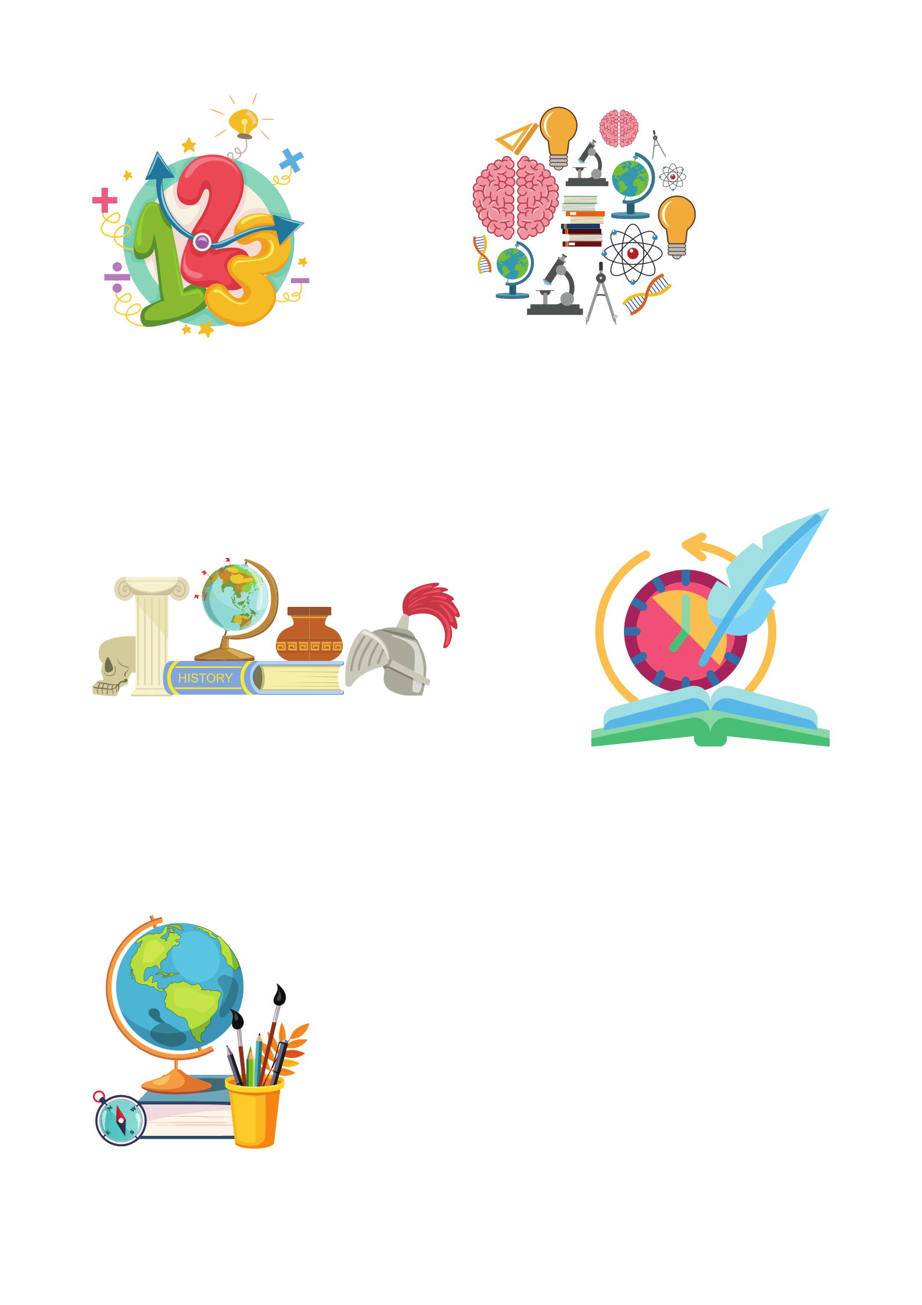
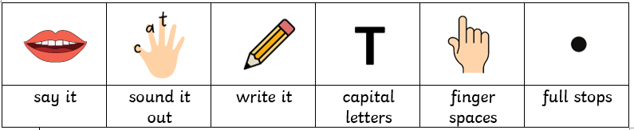
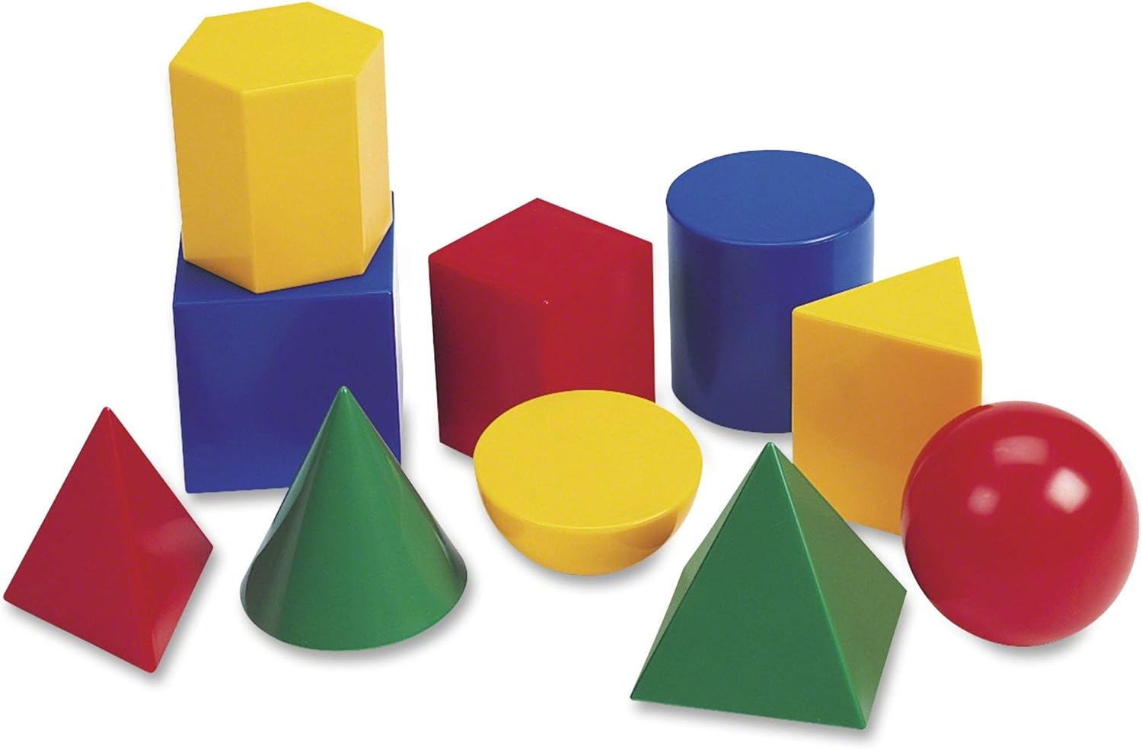

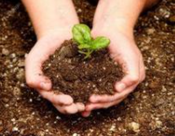
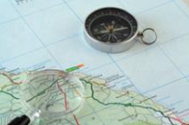

Year 2 newsletter—autumn 2
Journeying together with God
Welcome back everyone. We hope you all enjoyed your half term holiday.
We begin this half term with our new topic ‘Hot or Cold?’.
We have a lot of exciting things planned for Autumn 2.
Year 2 will be leading the nativity this year! They are very excited to put on an amazing show, and we have already started to practise singing our Christmas songs!
Theme and big question
Hot or Cold?
Would you rather live in a hot or cold place?
Our Christian value this half term is…
Perseverance
Key dates
Friday 14th November – Children in Need (non- uniform day)
Wednesday 26th November – Year 2 family breakfast
Tuesday 16th December – Y2 Stay and Christmas craft
Wednesday 10th December – KS1 Christmas Performance
Wednesday 3rd December – Christmas Fair
Please remember to bring your child’s book bag to school every day and check inside for new books and notices. Please ensure that PE kits are brought in for PE days, and that they are labelled with your child’s name. Remember to label all items of uniform too!
Please can all children bring their water bottles with them every day and filled with water only.
English
The children will continue to use a range of fiction and non-fiction texts as a writing stimulus. They will create fact files about penguins, incorporating their learning about cold places. They will also create an exciting adventure story. The children will be expected to write using their best handwriting.
maths
We will continue to recall number bonds to 10 and 100, identifying patterns and using the language ‘if I know that five plus five is ten, then fifty plus fifty equals one hundred. 5+5=10, 50+50=100. The children will continue completing the unit ‘addition and subtraction’.
They will then move onto shape which will include, recognising 2D and 3D shapes, counting sides and vertices on shapes, and finding lines of symmetry.
Computing
The children will be learning about the internet using Purple Mash. They will explore the roles of browsers, search engines, websites and webpages. We will cover Internet Safety.
Nurture
Discover
Respect

Slide 2



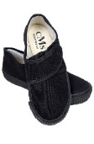
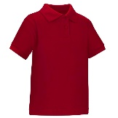







Year 2 newsletter—autumn 2
Journeying together with God
Science
Microhabitats
Living things and their habitats - The children will draw upon their learning from last half term about minibeasts and different habitats. They will learn how microhabitats are very small habitats wthin places we looked at last half term e.g. under a rock, on a leaf etc.
RE
Christianity – Gospel
What is the ‘good’ news Christians believe Jesus brings?
The children will listen to stories from the Bible and understand what they mean to Christians. They will understand that God forgives those who say sorry.
PSHE - One Life
We are safe!
During our One Life lessons, we will learn about emotions, regulating and calming our nervous system, manners and respect. We will also learn how we should love our body and make sure others respect our body, including safe touch.
Art
Drawing: Understanding Tone and Texture
The children will begin to generate ideas from a wider range of stimuli, exploring different media and techniques. They will also experiment in their sketchbooks, using drawing to record ideas. The children will talk about art they have seen as well as their own, using the appropriate vocabulary.
PE
PE days for both classes – Tuesday and Friday
There will be two PE lessons per week so please ensure PE kits are in for those days and are fully named.
This half term we will be focusing on ball skills (feet) and teamwork.
Geography
Would you prefer to live in a hot or cold place?
The children will be learning about continents, the equator and the North and South Poles. They will learn what life is like in a hot place, comparing the UK to Kenya. They will think about whether the place we live is a hot or cold place and express a preference as to whether they would like to live in a hot or cold place.
Home Learning
Please read as much as possible with your child. Try and aim to read with your child every day, for at least 10 minutes and make a short note in their reading diary.
It is also important that you read to your child as much as possible too!
Home learning will be given out every Friday and should be returned by the following Wednesday.
There will be a balance of English, maths and theme work throughout the year.
communication
Please ensure you check Seesaw regularly for important updates and letters.
Also, don’t forget to visit our Facebook, Twitter and class webpage to see all our learning in Y2 and school.
Nurture
Discover
Respect

