Slide 1







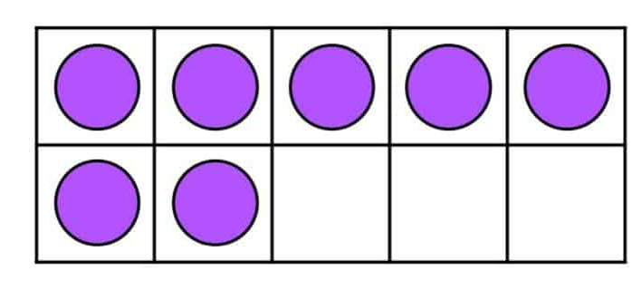

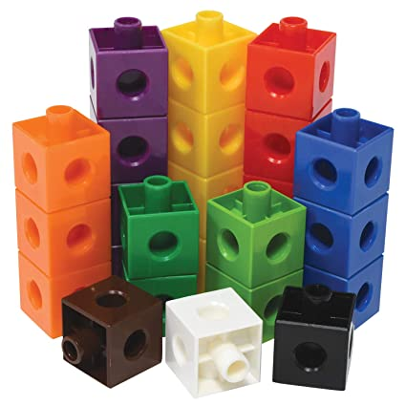




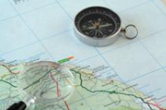

Year 5 newsletter—autumn 2
Journeying together with God
Theme and big question
Space
Big Question:
What’s out there?
Our Christian value this half term is…
Perseverance
Notices
Please ensure that you and your child have access to Seesaw and check it regularly, as it will be the main way that we send announcements and to communicate with you.
maths
The children will be following the White Rose Maths scheme of work focusing on:
Number: Multiplication and division - Children will develop learning on factors, multiples, square numbers and the link between the inverse operations multiplication and division.
Measurement: Perimeter and area
We will look at how we measure the perimeter and area of different shapes.
Geography
Would you like to live in a desert?
Key dates
Monday 10th November –Respect week Tuesday 11th November–Open morning
Thursday 13th November – School Disco – 4.45pm – 6pm
Friday 14th November – Children in Need – non-uniform day with a £1 donation
Wednesday 3rd December – Christmas Fayre
Thursday 18th December - Carol service – 11am – St Peter’s Church
Friday 19th – Christmas Jumper Day – break up for Christmas holidays
English
In English we will be…
Debating- Is space exploration is a waste of money?
Creating a balanced argument - write a balanced argument about the pros and cons of Space travel.
Nurture
Discover
Respect

Slide 2








Year 5 newsletter—autumn 2
Journeying together with God
Science
Space
Children will learn to describe the movement of the Earth and other planets relative to the sun in the solar system.
RE
Incarnation
Was Jesus the Messiah?
ART
Drawing, depth and emotion
Exploring mark making for showing depth, emotion and movement.
VIPERS
We will read Survival in Space
and explore the vocabulary,
make predictions and
summarize extracts from the
text.
PSHE
One Life – we will be learning more about our own emotions: recognising and understanding emotions, accepting that all emotions are valid but learning how to manage them so they don’t grow too big.
We are participating in the Linking Schools Network this year and this term we will be meeting our Link class and class teacher via zoom!
PE
Tuesdays & Fridays – PE
Please remember children must come to school in correct PE kit on these days.
Home Learning
Homework is handed out on a Friday and collected in on the following Wednesday. Please ensure that homework is completed in pencil and well-presented when in the homework book. If your child would prefer to complete their homework on Seesaw, please ensure they hand it in by Wednesday as well.
It is encouraged that children regularly access TTRockstars independently to improve fluency and accuracy. Children should also be reading regularly at home, even if they are a fluent reader.
communication
Don’t forget to visit our Facebook, Twitter and class webpage to see all our learning in Y5 and school.
Nurture
Discover
Respect

