Slide 1









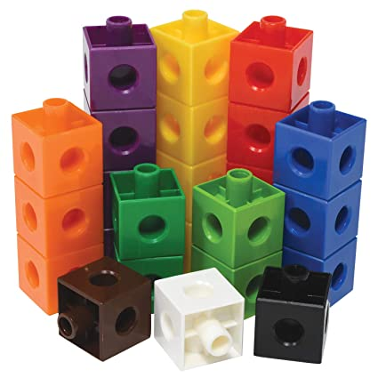

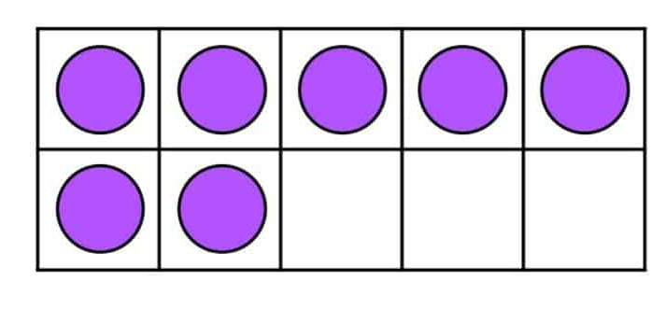
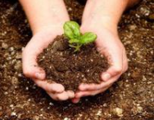
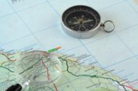

Year 5 newsletter—autumn 1
Journeying together with God
Welcome to Year 5. We hope that you have all had a restful and enjoyable summer. We are looking forward to getting settled into a new year and getting to know you all. The children will be learning lots of exciting, new things and we are looking forward to see each child thrive on their learning journey. The staff who will be working regularly in Year 5 will be Miss Carter, Miss Sedman, Mr Mulvihill, , Miss Brighouse, Miss Dixon, Miss Horsfall and Mrs Bell.
Theme and big question
The Vikings
Big Question:
Were the Vikings ruthless killers or peaceful settlers?
Our Christian value this half term is…
Generosity
Key dates
Friday 26th September- Harvest Services at Bramley Baptist Church- 11.00am
Wednesday 24th- Individual photos in school
Wednesday 22nd October- Parents’ Evening -3.30-7.00pm
Thursday 23rd October- Break up for half term
Friday 24th October- Teacher Training Day- No children in school.
Notices
Please ensure that you and your child have access to Seesaw and check it regularly, as it will be the main way that we send announcements and to communicate with you.
maths
The children will be following the White Rose Maths scheme of work focusing on:
• The place value of numbers, including place value within decimal numbers.
• Developing our understanding of written methods for addition and subtraction.
• Solving addition and subtraction multi-step problems in context.
• Performing mental calculations, including with mixed operations and large numbers.
• Learning to read, recognise and write Roman numerals and use these within context.
English
In English we will be…
• Reading the book, ‘Odd & the Frost Giants’ by Neil Gaiman which links to our topic ‘Ruthless killers or peaceful settlers?’
• We will be completing various writing tasks inspired by the story with a focus on character and setting descriptions and myths.
• Developing our reading comprehension through discussion and questioning on a variety of texts using VIPERS.
Nurture
Discover
Respect

Slide 2








Year 5 newsletter—autumn 1
Journeying together with God
Science
Forces
Big question: How do things move?
We will investigate what forces are and how they are measured. We will look at gravity and the effect it had on unsupported objects. We will also investigate the effects of friction and air and water resistance.
RE
Judaism
We will explore what it means for a Jewish person to follow God.
PSHE
One Life- We are happy
The lessons will build on children’s understanding of themselves and will build their self awareness. We will look at how we look at ourselves and how we build friendships and look after our physical well being with food and nutrition.
DT
Mechanisms
We will create a functional four-page pop-up storybook design, using lever, sliders, layers and spacers to create paper-based mechanisms.
PE
Our P.E days for this year will be Tuesdays and Fridays. Friday will be athletic skills and will be outside PE and Tuesday will be indoor PE and will focus on orienteering skills.
On PE days, children can come to school in their PE kit, but this must follow the PE kit expectations (this can be found on the school website).
VIPERS
We will be focusing on different reading skills whilst reading our class book ‘Arthur and the Golden Rope’. These will Include: exploring the vocabulary used, making inferences, predicting what will happen next, explaining meaning, retrieving information from the text and summarizing sections of information.
Home Learning
Homework is handed out on a Friday and collected in on the following Monday. Please ensure that homework is completed in pencil and well-presented when in the homework book.
It is encouraged that children regularly access Spelling Shed and TTRockstars independently to improve fluency and accuracy. Children should also be reading regularly at home, even if they are a fluent reader.
communication
Please ensure you check Seesaw regularly. We will give you a new log in for your child to access their new Y5 online journal.
Also, don’t forget to visit our Facebook, Twitter and class webpage to see all our learning in Y6 and school.
Nurture
Discover
Respect

