Slide 1











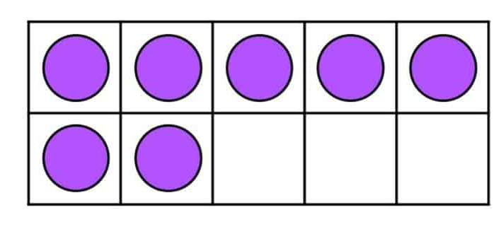

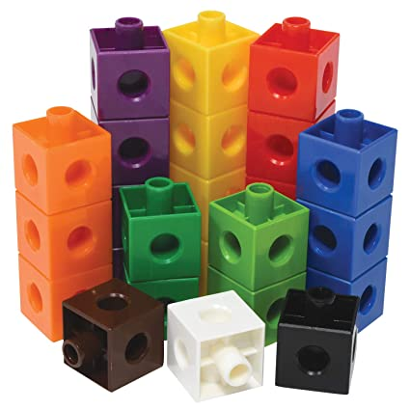
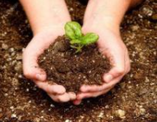
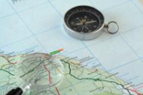

Year 6 newsletter—Spring 1
Journeying together with God
Happy New Year!
We hope you have all had a lovely Christmas and New Year. Thank you for your continued support over the Autumn term. Unfortunately, we are noticing a rise in incidents related to phones, particularly WhatsApp groups. Please ensure you are checking your child’s internet restrictions and monitoring what your child is doing on their phone regularly. Later in the half term, we will have Safer Internet Day, ran by Mr Cave, where the children will be reminded about the risks of being active online.
Theme and big question
World War 2
Why was World War 2 so catastrophic for Nazi-controlled
countries?
Our Christian value this half term is…
peace
Friday 2nd February – Science Day
Tuesday 6th February – Safer Internet Day
Friday 9th February – Local Charity Day
Friday 9th February – Break up for Half Term
Key dates
Notices
We have seen an increasing number of children wearing non-uniform / jewellery at school this academic year. Please ensure your child comes to school in the correct uniform. The full uniform policy is on the school website.
maths
This half term we will be:
Converting units in weight, length and capacity.
Working with decimals and percentages building up to converting between them and fractions.
Continue to consolidate arithmetic concepts and methods.
English
We will be starting our new class novel, ‘Once’ by Morris Gleitzman.
As part of our WW2 topic, we will produce writing such as explanation texts, diaries, stories and newspaper articles.
We will be focusing on emotive language derived from our topic.
This topic is of a sensitive nature and although we will handle appropriately, please be aware your children may have questions.
Nurture
Discover
Respect

Slide 2







Year 6 newsletter—spring 1
Journeying together with God
Science
In Science we will be learning all about the circulatory system; we will particularly be focusing on the heart as a muscle and exploring how blood is transported around the human body. This is within the topic ‘Animals including Humans’ and gives the children opportunities to extend their prior knowledge of systems in the human body.
RE
What will make our city a more respectful place?
We will be exploring and analysing local data about religion and how it has changed over time. We will look at the impact religion has on communities and what may happen if religion was removed.
PSHE
Relationships, sex and education
Please read carefully the separate letter on this topic
Art
Drawing: Make my voice heard
This unit focuses on developing pupils' skills in using different art styles, understanding and applying chiaroscuro and creating symbolic and expressive drawings. It encourages children to form their own opinions about art, understand the impact of techniques, and convey messages through their artwork.
PE
The topics for our PE sessions this half term include:
Health Related Exercise on Tuesdays with Miss Horsfall and Mrs Akhondi.
Gymnastics (Matching and Mirroring) on Thursday mornings with Miss Garner and Miss Shoesmith.
Geography
Mountains
We will be learning about mountains, answering the question: ‘Are all mountain ranges the same?’.
We will explore various mountainous areas around the world and look at the pros and cons of living in these kinds of environment.
Home Learning
Over the next few weeks, your child will receive some revision packs which we encourage to be used regularly at home in the run up to the SATS.
Homework is handed out on a Friday and collected in on the following Monday. Please ensure that homework is completed and well-presented.
It is encouraged that children regularly access Spelling Shed and TTRockstars independently to improve fluency and accuracy. Children should also be reading regularly at home, even if they are a fluent reader.
communication
Please ensure you check Seesaw regularly
Also, don’t forget to visit our Facebook, Twitter and class webpage to see all our learning in Y6 and school.
Nurture
Discover
Respect

