Slide 1
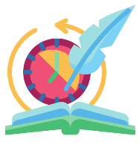

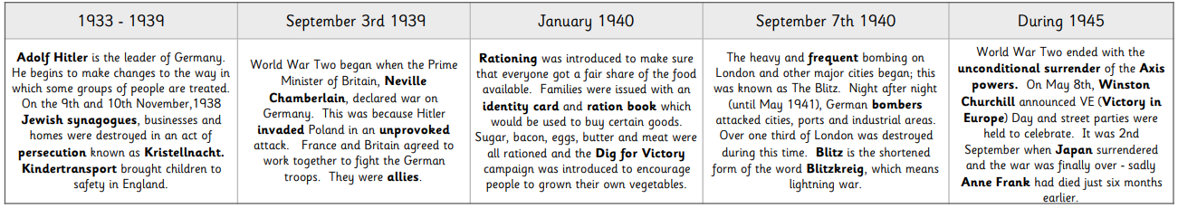
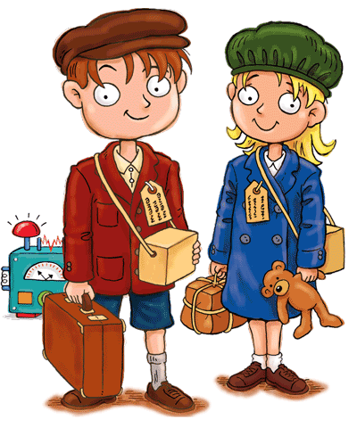
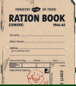
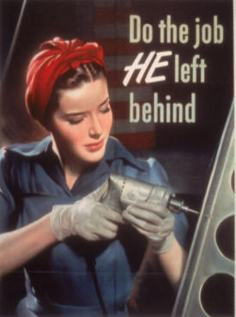
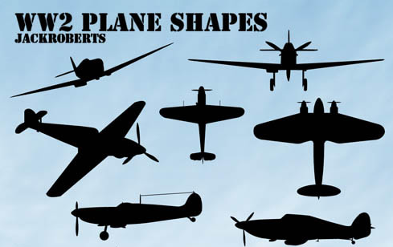
Year 6
History
WWII What was it like to live in Britain during World War 2?
Timeline of Events
Key Knowledge
Roles of women: Before the war, most women stayed at home and didn’t go out to work. However, when men were called up for active service, women were needed to do jobs such as making weapons, driving buses and trains or working in engineering or shipbuilding. Some joined the armed forces themselves. Evacuation: Many people (mostly children) were evacuated from the cities to the countryside, where it was believed they would be safer from bombing. All evacuees had to take their gas mask, ration book and identity card. Rationing: Supply ships were targeted by German bombers and it was necessary to conserve as much food as possible. Rationing meant that each person was only allowed a fixed amount of foods. The Government used propaganda to encourage the public’s participation in the war effort.
Significant Individuals
Adolf Hitler (1889-1945) leader of the Nazi political party, known to have very extremist views and responsible for millions of deaths. Neville Chamberlain - British Prime Minister from 1937-1940; Chamberlain was Prime Minister when Britain declared war on Germany. Winston Churchill -British Prime Minster from 1940 to 1945
Key Vocabulary and Phrases
Conscripted | To be called up to the armed services.
Propaganda | Information designed to promote a political idea or opinion.
Evacuee | Someone who was evacuated, moved from a danger area to a safer place (normally from the cities to rural areas)
Rationing | The controlled distribution of scarce resources (mainly food & clothing)
Blackout | System of ensuring no lights were visible after dark so that buildings could not be spotted by enemy planes
Air raid | The name given to the time when enemy aircraft dropped bombs on cities - people often found safety in air raid shelters

