Slide 1





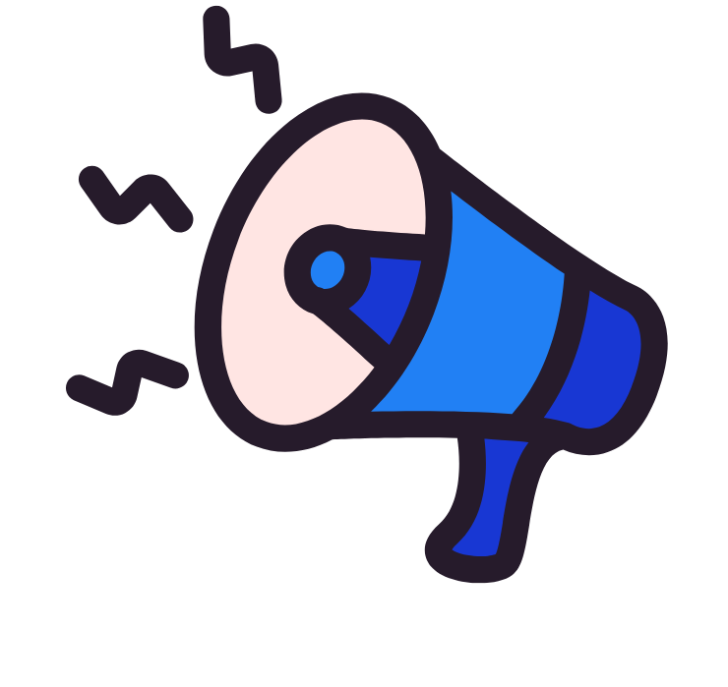


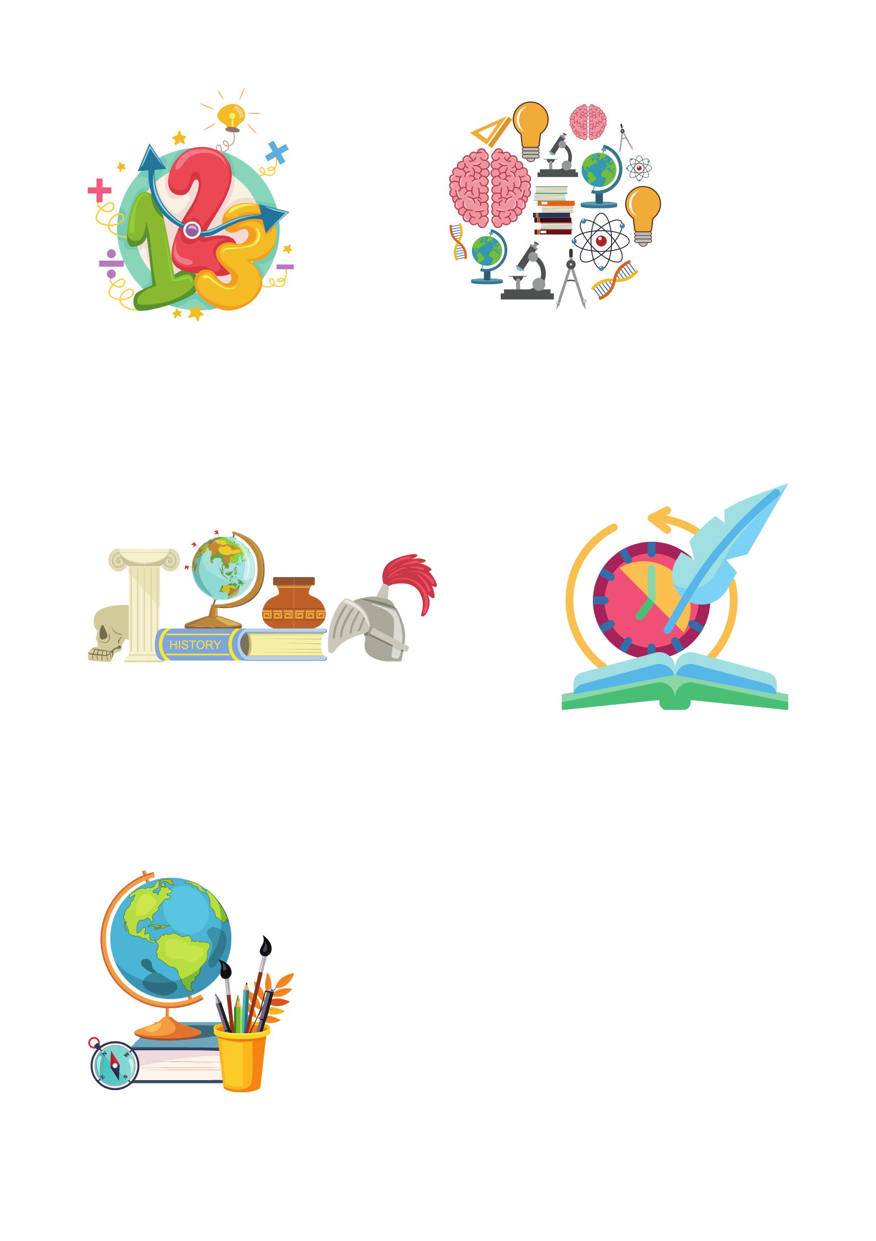
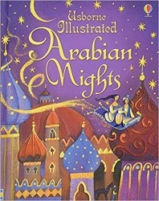
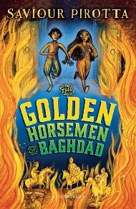

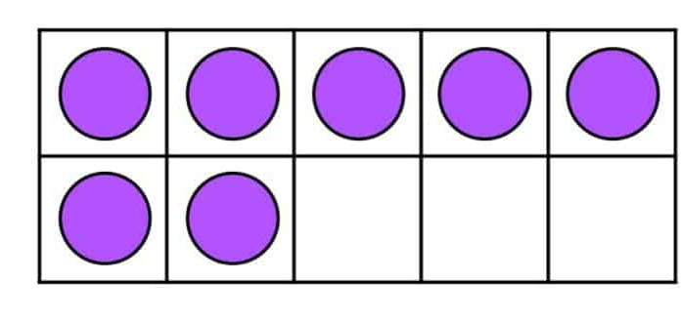

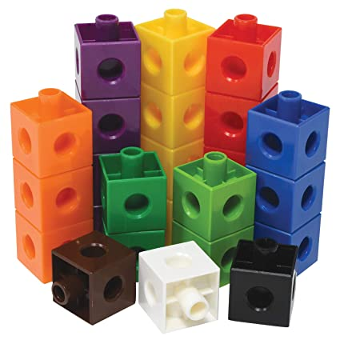
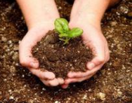
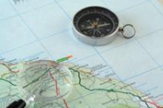

Year 5 newsletter—Spring 1
Journeying together with God
Happy New Year!
We hope you have all had a lovely Christmas and New Year. Thank you for your continued support over the Autumn term. We appreciate it has been a strange start to the new year with the snow and ice and we thank you for your flexibility.
Theme and big question
The Golden Age of Islam
Why did the Golden Age of Islam shine?
Our Christian value this half term is…
Trust
Friday 31st January – Science Day
Tuesday 11th February – Safer Internet Day
Friday 14th February – Break up for Half Term
Key dates
Notices
We have seen an increasing number of children wearing non-uniform / jewellery at school this academic year. Please ensure your child comes to school in the correct uniform. The full uniform policy is on the school website.
English
Reading and answering VIPERS questions about the book ‘The Golden Horsemen of Baghdad’ by Saviour Pirotta.
Writing their own story for the ‘1001 Arabian Nights’ collection.
Developing narrative paragraphs based on our class novel.
Writing non-chronological reports about the Golden Age of Islam.
maths
This half term we will be:
Multiplying numbers up to 4 digits by a one digit or two digit number using a formal written method.
Dividing numbers up to 4 digits by a one digit number using the formal written method of short division.
Solving problems involving addition, subtraction, multiplication and division.
Comparing and ordering fractions whose denominators are multiples of the same number.
Solving a range of reasoning problems.
Nurture
Discover
Respect

Slide 2







Year 5 newsletter—spring 1
Journeying together with God
PSHE
In PSHE, year 5 will be learning about mental health and emotional wellbeing. The children will explore their understanding of emotions and how changes in our lives can have an effect on what we feel. We will be exploring feelings associated with loss, grief and bereavement.
RE
What does it mean for Muslims to follow God?
In RE, the children will be learning about the five pillars of Islam, retelling the story of how the Qur’an was revealed to Muhammed and exploring how the different elements of a mosque can explain how they reflect Muslim beliefs.
PE
The topics for our PE sessions this half term include Health Related Exercise and Badminton on Tuesdays (with Miss Horsfall and Mrs Akhondi) and
Friday afternoons (with Miss Carter and Miss Shoesmith).
Art
Architecture
Investigating the built environment through drawing and printmaking, learning about the work of architect Zaha Hadid
History
In history the children will be learning about the Early Islamic Civilisation and our topic question is, ‘Why did the Golden Age of Islam shine?’ During this topic the children will learn about Baghdad in 900CE, compare life in Baghdad to life in England at the time and consider the rise and fall of the Islamic civilisation during this period of time.
Home Learning
Homework is handed out on a Friday and collected in on the following Wednesday. Please ensure that homework is completed and well-presented.
It is encouraged that children regularly access Spelling Shed and TTRockstars independently to improve fluency and accuracy. Children should also be reading regularly at home, even if they are a fluent reader.
If there are more snow days please ensure you check on Seesaw for any home learning activities.
communication
Please ensure you check Seesaw regularly
Also, don’t forget to visit our Facebook, Twitter and class webpage to see all our learning in Y6 and school.
Nurture
Discover
Respect

