Slide 1





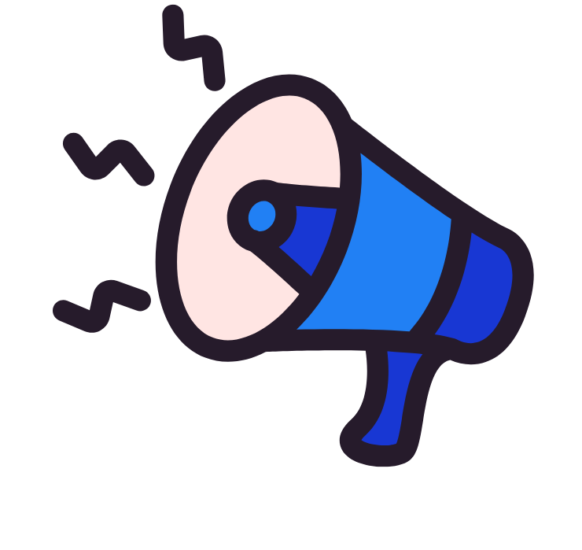


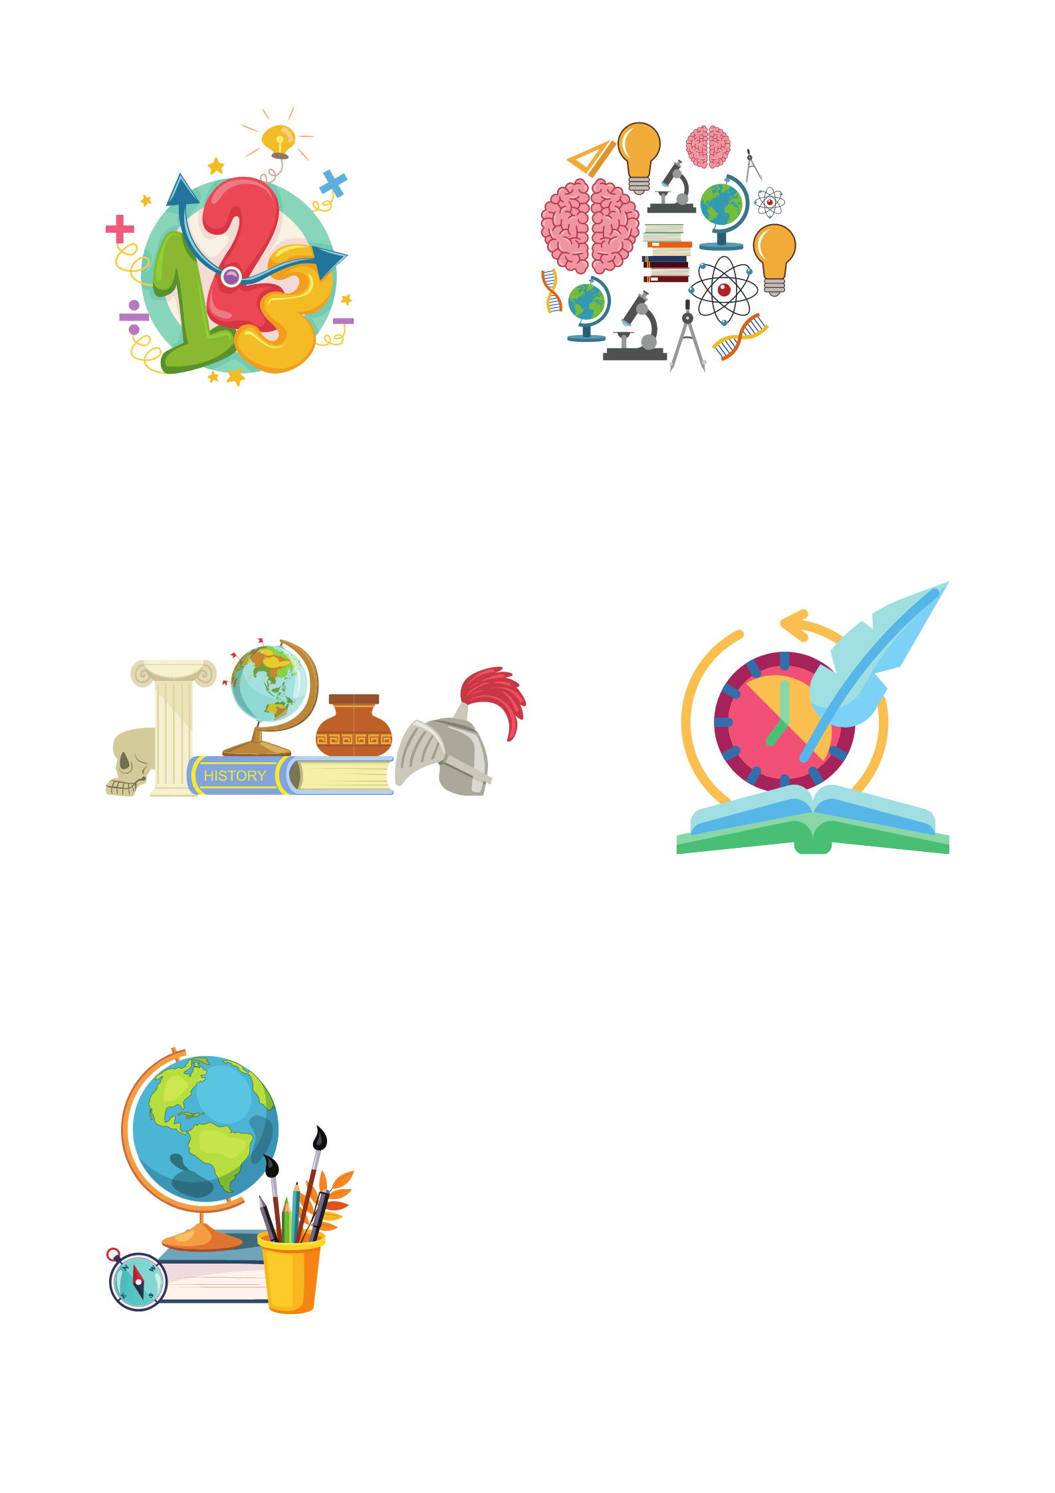


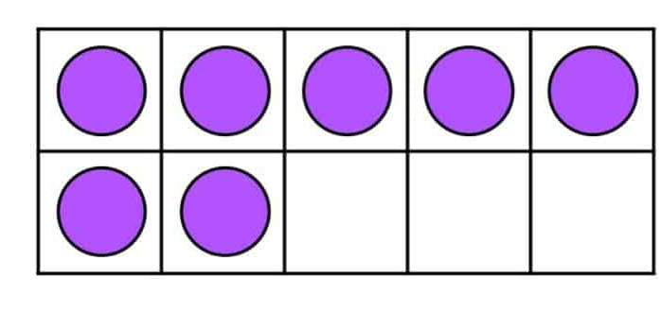

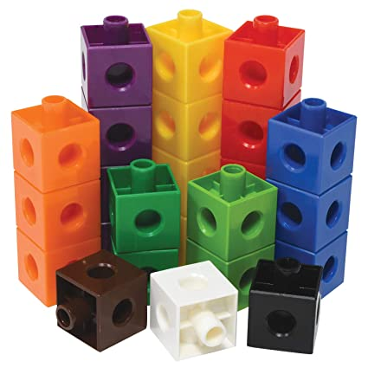
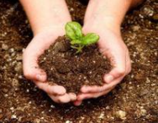
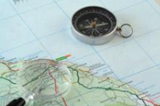

Year 6 newsletter—Spring 1
Journeying together with God
Happy New Year!
We hope you have all had a lovely Christmas and New Year. Thank you for your continued support over the Autumn term. Unfortunately, we are noticing a rise in incidents related to phones, particularly WhatsApp groups. Please ensure you are checking your child’s internet restrictions and monitoring what your child is doing on their phone regularly. Later in the half term, we will have Safer Internet Day, ran by Mr Cave, where the children will be reminded about the risks of being active online.
Theme and big question
The Circulatory System
What is the role of the circulatory system in our bodies?
Our Christian value this half term is…
Responsibility
-Monday 5th January – Healthy Inside and Out Day – First Aid Visitor
-Wednesday 14th January – Stay and Read 2:30-3:00pm
-Tuesday 10th February – Safer Internet Day
-Friday 13th February – Break up for Half Term and Local Charity Day
Key dates
Notices
We have seen an increasing number of children wearing non-uniform / jewellery at school this academic year. Please ensure your child comes to school in the correct uniform. The full uniform policy is on the school website.
English
We will be starting our new class novel, ‘Murder at Twilight’.
As part of our topic, we
will produce writing
such as a crime scene
report and suspense
mystery narrative.
The children will practise lots of literacy devices including using the passive voice, synonyms and a range of sentence structures for impact on the reader.
maths
This half term we will be:
Calculate ratios and understanding the links to fractions
Working with decimals and percentages building up to converting between them and fractions.
Continue to consolidate arithmetic concepts and methods.
Nurture
Discover
Respect

Slide 2


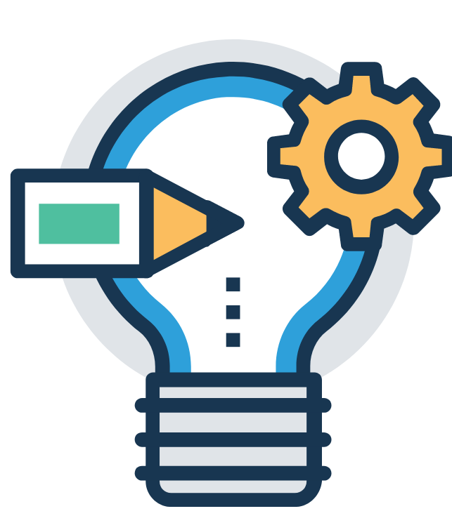


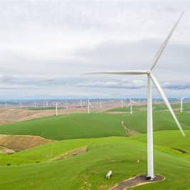


l
Year 6 newsletter—spring 1
Journeying together with God
Science
In Science we will be learning all about the circulatory system; we will particularly be focusing on the heart as a muscle and exploring how blood is transported around the human body. This is within the topic ‘Animals including Humans’ and gives the children opportunities to extend their prior knowledge of systems in the human body.
RE
What will make our city a more respectful place?
We will be exploring and analysing local data about religion and how it has changed over time. We will look at the impact religion has on communities and what may happen if religion was removed.
MUSIC
You’ve got a friend
Music Genre: 70’s Ballads/Pop
Art
Drawing: Expressing ideas
This unit focuses on developing pupils' skills in using different art styles, understanding and applying chiaroscuro and creating symbolic and expressive drawings. It encourages children to form their own opinions about art, understand the impact of techniques, and convey messages through their artwork.
PE
The topics for our PE sessions this half term include:
-Health Related Exercise on Tuesdays with Mrs Bell and Mrs Akhondi.
-Handball will be on Thursdays with Mrs Gatehouse and Miss Shoesmith.
Geography
Energy
We will be learning about where our energy comes from, renewable and non-renewable energy and the benefits and drawbacks of different sources.
We will explore where you
can find different energy
Sources in the UK and
transport links for trading
routes.
Home Learning
Homework is handed out on a Friday and collected in on the following Monday. Please ensure that homework is completed and well-presented.
It is encouraged that children regularly access TTRockstars independently to improve fluency and accuracy. Children should also be reading regularly at home, even if they are a fluent reader.
communication
Please ensure you check Seesaw regularly
Also, don’t forget to visit our Facebook, Twitter and class webpage to see all our learning in Y6 and school.
Nurture
Discover
Respect

