Slide 1



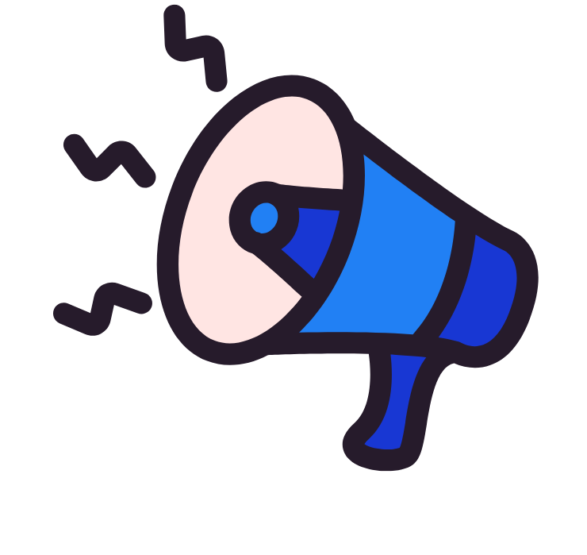

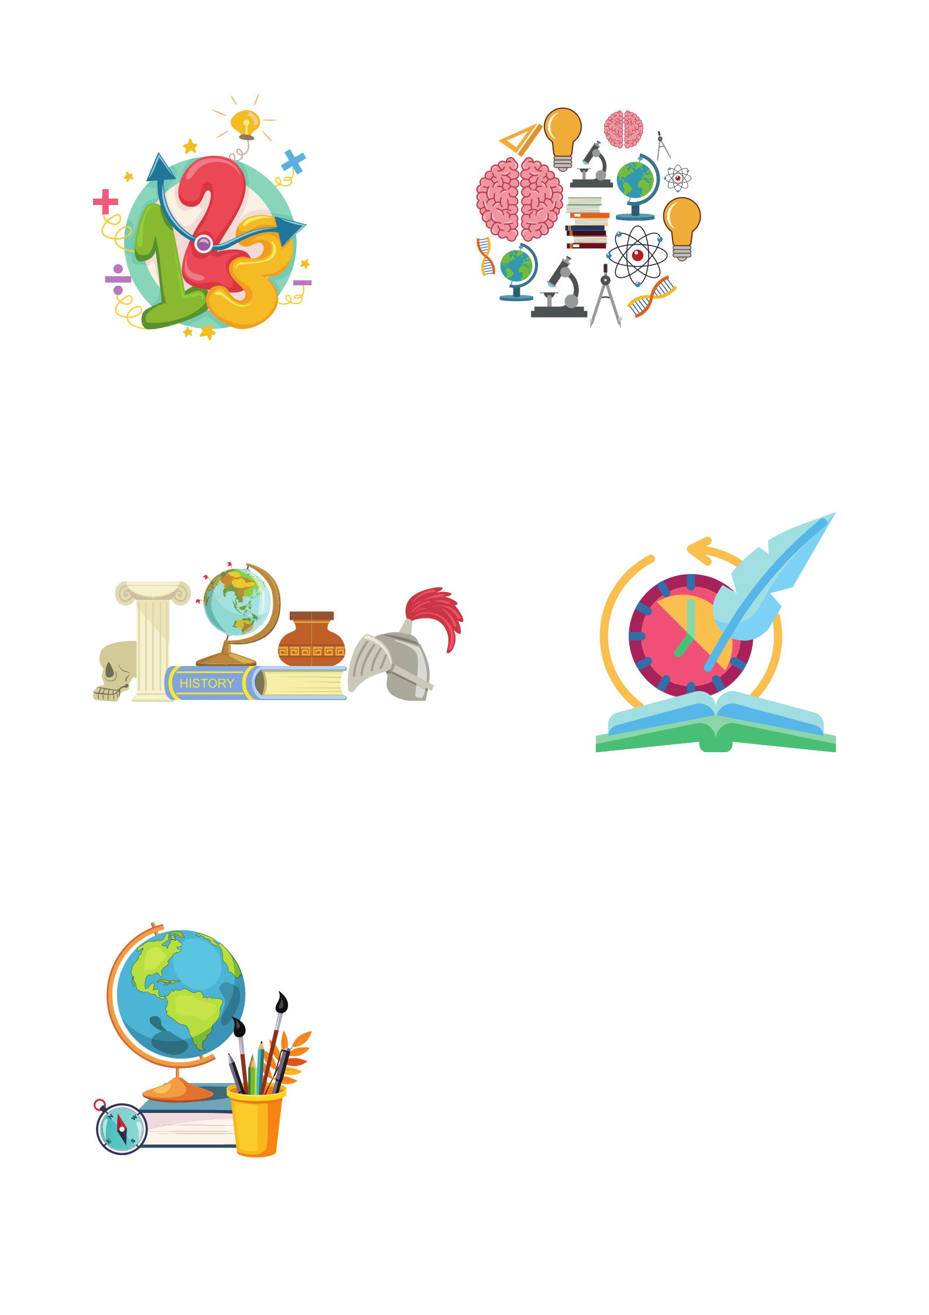



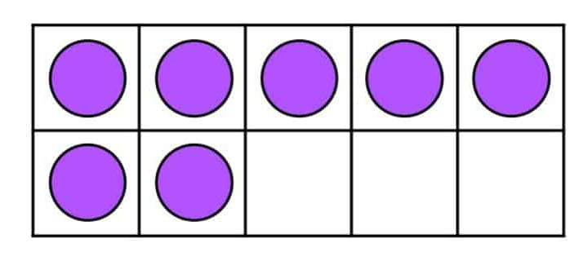

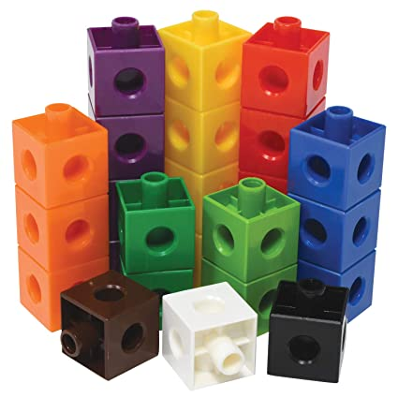
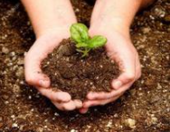
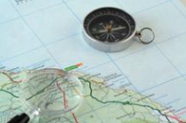

Year 6 newsletter—Spring 2
Journeying together with God
Welcome back to a new half term, and thank you, as always, for your continued support throughout the school year.
We are currently finalising plans for our exciting educational visit to Eden Camp Modern History Museum. This immersive museum brings history to life through engaging displays that recreate the sights, sounds and experiences of both the Home Front and the Front Line. The visit will enrich our learning across a range of subjects, including history, art, religious education, citizenship, geography, design technology and science. It promises to be a memorable and meaningful way to conclude our World War II topic
Theme and big question
World War 2
What was it like living in Britain in World War 2?
Our Christian value this half term is…
Love
Notices
Over the coming weeks, we will be introducing SATs revision sessions for selected pupils. If your child is invited to attend, it is because we believe they would benefit from some additional support in preparation for the tests. We would greatly appreciate your encouragement in ensuring they attend these sessions whenever possible.
.
Key dates ​
Monday 23rd February – Wednesday 4th March Gallery poetry award class competition
Thursday 5th March – World Book Day
Monday 9th – Friday 13th March- Mother's Day celebrations​
Wednesday 11th March – Gallery poetry award final
Monday 30th March – Eden Camp trip.
Tuesday 31st March – 11am – Easter Service at St Peter's Church
Tuesday 31st March- Parents’ Evening- 3.30-5.00pm​
Wednesday 1st April- Parents’ Evening- 3.30-7.00pm​
maths
In preparation for the SATs, the children will receive an additional maths lesson each week to further strengthen their understanding and confidence. Within their maths groups, we will be revisiting and developing a range of key concepts to ensure they are fully prepared.
Over the coming weeks, we will be focusing on:
Decimals, fractions and percentages
Calculating the area, perimeter and volume of different shapes
The revision guides sent home at the end of last term contain helpful practice and guidance on all of these topics. We encourage regular use of these materials to support learning at home.
English
This half term, we will begin our new class novel, Letters from the Lighthouse by Emma Carroll. The text will provide rich inspiration for our writing, including newspaper reports and persuasive speeches. We will also study Rose Blanche by Ian McEwan, which will further support our understanding of World War II themes.
Through these texts, we will explore and apply key grammatical features such as the passive voice, the subjunctive form and the use of time adverbials.
In reading, we will continue to develop our comprehension skills, with a particular focus on questions linked to the writer’s choice and the impact of language.
Nurture
Discover
Respect

Slide 2





Year 6 newsletter—Spring 2
Journeying together with God
Science
In Science this half term, we will be exploring the topic of light and how it enables us to see the world around us. The children will take part in a range of practical investigations to develop their understanding of how light travels in straight lines and how this affects the way we see objects. They will explore how shadows are formed, how they change in size, and what this tells us about the position of a light source.
RE
What difference does the resurrection make to Christians?
In this unit, we will explore some of the key concepts and teachings found within the Bible, focusing particularly on the Easter story. The children will examine different eyewitness accounts of the resurrection, comparing perspectives and considering what these narratives reveal about faith and belief.
PE
The topics for our PE sessions this half term include:
Quidditch on Tuesday with Mrs Bell and Mrs Akhondi
Health Related Exercise on Thursday with Miss Gatehouse and Miss Shoesmith.
Revision opportunities
Every Tuesday at breaktime, Mr Muckelt will run a homework club to support any children who have been unable to complete their homework at home. This provides a quiet, structured environment where pupils can catch up and seek help if needed.
In addition, any child who would welcome some extra revision support is encouraged to attend and bring along their revision booklet. This is a valuable opportunity to ask questions, revisit tricky concepts and build confidence ahead of the SATs.
PSHE
RSE
This term, our One Life theme that we will be focusing on is showing compassion to ourselves, others and the environment. Later in the term, we will be covering Relationships and Sex Education. We will teach the children about as puberty, relationships and communication skills, stereotyping, conception and pregnancy, roles and responsibilities and Female Genital Mutilation (FGM).
history
In History, we will continue our study of World War II, with a particular focus on how the war impacted Britain and everyday life at home. Through a range of sources, discussions and activities, the children will deepen their understanding of how the conflict shaped communities across the country.
We will explore key aspects of the period, including the Blitz and its effect on cities and families, the introduction of rationing and how it changed daily life, the vital roles women played both at home and in the workforce, and the experiences of children who were evacuated from urban areas to the countryside.
Home Learning
Homework is set on a Friday and should be returned by the following Monday. Please support your child in ensuring that all homework is completed to a high standard and presented neatly, taking pride in the quality of their work.
We strongly encourage children to access Times Tables Rock Stars regularly at home to help improve their spelling accuracy and times table fluency. Frequent practice in short bursts can make a significant difference to confidence and speed.
Reading at home should also remain a priority.
communication
Please ensure you check Seesaw regularly
Also, don’t forget to visit our Facebook, Twitter and class webpage to see all our learning in Y6 and school.
Nurture
Discover
Respect

