Slide 1









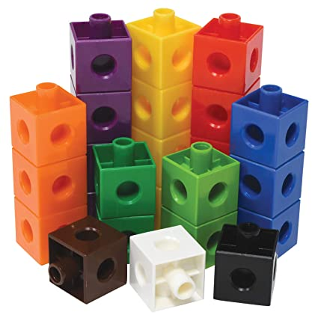

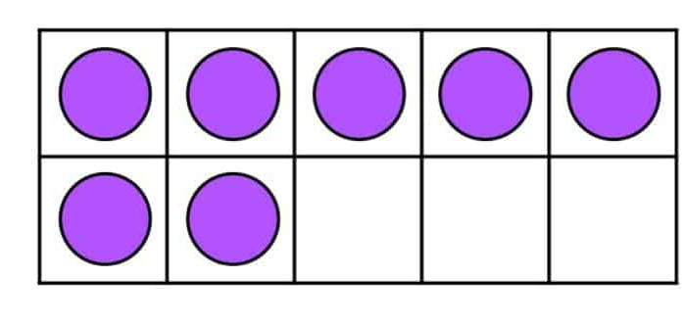
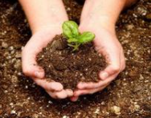
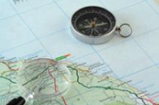

Year 6 newsletter—summer 1
Journeying together with God
The Year 6 SATs are fast approaching, the children will be working hard in these last few weeks to revise aspects of maths, grammar and reading that they find difficult within school. We are very impressed with the continued hard work and positive attitude that the children have displayed to their learning and they have made excellent use of the revision guides we gave them in Spring Term. Please help us by encouraging your child to keep up the great work – not long left! You can also support your child by ensuring they are getting enough sleep and have a good breakfast before they come to school. We will be running a breakfast club for Year 6 during SATS week, which your child is welcome to come along to from 8am each morning (Mon-Thurs). At the end of SATs Week, we will be hosting a party for the children to celebrate all their hard work.
Theme and big question
Evolution
If humans evolved from apes, why do apes still exist?
Our Christian value this half term is…
PRAYER
SATs week
Monday 11th May – Grammar and spelling papers
Tuesday 12th May – Reading paper
Wednesday 13th May – Maths Paper 1 (arithmetic) and Paper 2 (Reasoning 1)
Thursday 14th May – Maths Paper 3 (Reasoning 2)
Key dates
Monday 4th May – Bank Holiday Monday
Monday 11th – Thursday 14th May – SATS week
Tuesday 19th May – Pentecost services at 10am at St Peter’s Church
Friday 22nd May – Brownlee Triathlon and break up for Half Term
English
We will continue to improve our reading comprehension skills, particularly on questions relating to inference and multiple mark questions. We will focus on improving our vocabulary and varying our sentence structures in preparation for SATs.
Within our writing sessions, we will be:
Writing an alternative ending for ‘Alma’
Using persuasive skills to debate ‘Should I go straight to High School after SATs?’
We will be revising various grammar, punctuation and spelling in preparation for the KS2 SATS.
Maths
The children will be using the White Rose Maths scheme of work to continue learning the KS2 Maths Curriculum. We will be continuing to revisit previous topics to build on prior knowledge.
In these last few weeks before SATS, please encourage your child to independently use the revision guides we provided. If your child is not fluent with their times tables up to 12x12, then they should be accessing TTRockstars regularly.
Nurture
Discover
Respect

Slide 2







Year 6 newsletter—summer 1
Journeying together with God
Science
Living things – Evolution and Inheritance
This term in Science, we will be looking at Charles Darwin’s theory of evolution. The children will be defining and identifying variation in organisms and recall that it is caused by inherited and environmental factors, describing patterns of inheritance from parent to offspring in a given example or family tree.
RE
Christianity – Kingdom of God
Our enquiry question for this term is ‘What kind of king is Jesus?’ We will be exploring a range of sources to develop our understanding of the Kingdom of God. We will then complete a project pitching ideas for how we can develop our local community.
PSHE
The Power of Now
As part of our One Life learning, we will be focusing on the importance of being present and engaged in the moment, which can lead to
greater peace, clarity and fulfillment. We will explore techniques to help us do this and add to our mindfulness toolbox.
FGM
As stated in the Relationships and Sex Education letter last term, part of our learning involves children understanding female genital mutilation. If you would like your child to be withdrawn from this learning please speak to a member of the Year 6 staff. You can find out more about this from the RSE policy on the school website.
DT
Textiles: Waistcoats
Children will be designing a waistcoat in accordance with a specification and design criteria to fit a specific theme, use a template to mark and cut out a design, use a running stitch to join fabric, attach a secure fastening, as well as decorative objects and evaluate their final product.
PE
This term we will be studying the two following areas in PE: Cricket & Hockey.
Please ensure on Mondays and Thursday your child is in suitable PE kit
.
In Cricket, we will be focusing on catching and striking and applying these into a wider team context.
In Hockey we will be practicing dribbling, passing with precision as well as working together as a team.
Home Learning
In the run up to SATs, homework will continue to be using revision guides and practising spellings. Once SATs are done, we will return to handing out homework on Fridays and it should be returned on Mondays, presented well and to a high standard.
Homework is an important part of ensuring your child is preparing for High School where they will continue to build on their independence with learning. Please encourage your child to complete homework and hand it in promptly.
communication
Please ensure you check Seesaw regularly. We send regular updates and notices from the school office. Also, don’t forget to visit our Facebook, Twitter and class webpage to see all our learning in Y6 and school.
Nurture
Discover
Respect

