Slide 1




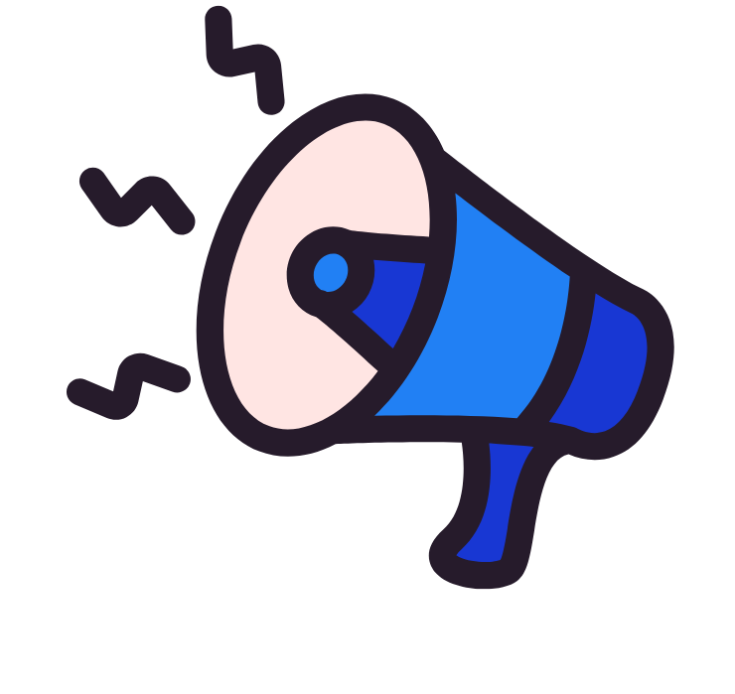


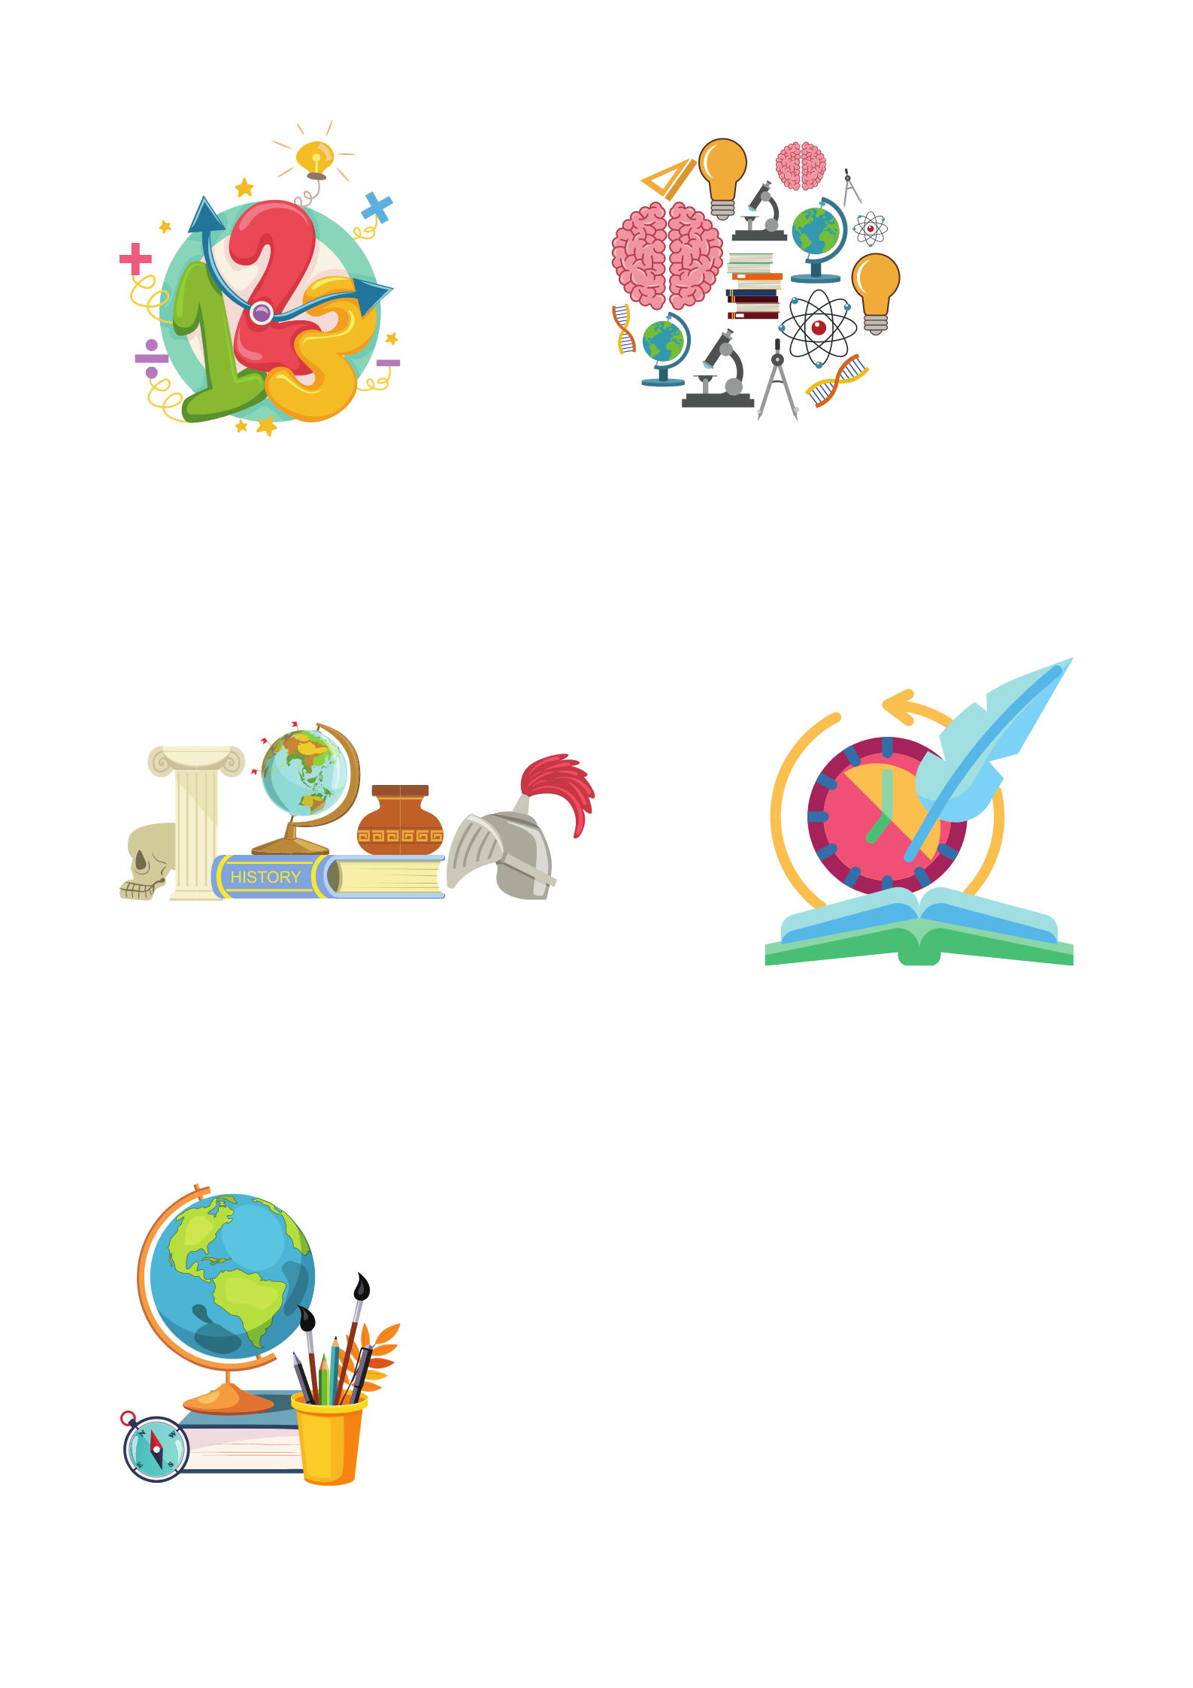

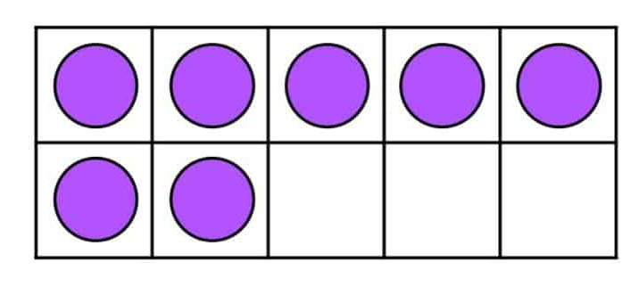

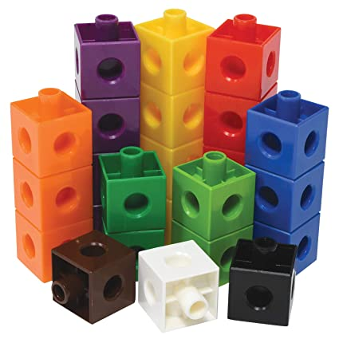
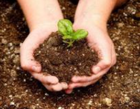
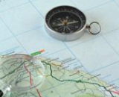

Year 6 newsletter—Autumn 1
Journeying together with God
Welcome to the first term of Year 6! We are delighted to begin this exciting and important year with the children. This year, every class in school is named after a tree, and our Year 6 children are proud to belong to Oak and Maple classes. Over the coming weeks, pupils will settle into new routines, build confidence and embrace fresh challenges as they grow as independent learners. Please look out for further information about the Year 6 residential to Robin Wood, which will be shared in due course. Thank you for your continued support; we look forward to working in partnership with you to make the year happy, successful and memorable.
Theme and big question
Population
How does population change?
Our Christian value this half term is…
Courage
Key dates ​
Thursday 10th September: Robinwood information evening.
Monday 21st September: Flu vaccinations in school.
Friday 25th September: Harvest Church Service
Wednesday 21st October: Parents evening.
Notices
This year, Oak and Maple classes will have PE on Tuesdays and Wednesdays. Children should come to school wearing their PE kit on both days.
Year 6 children may walk home independently, but only with written consent from a parent or guardian. Without written consent, children will remain in school until they are collected.
English
We are launching our new English programme this half term with an immersive hook designed to bring the wordless picture book Arrival to life. Children will develop their ideas towards a final fiction piece: an adventure narrative centred on a disaster and inspired by the text.
For non-fiction, they will write an information text exploring how populations have increased over time, making clear links with this term’s geography topic.
maths
This term begins with place value, as children are introduced to seven-digit numbers for the first time. During Autumn 1, we will also focus on addition, subtraction and multiplication. Regular practice on TTRS at home will strengthen times-table fluency and support children’s learning in class.
Nurture
Discover
Respect

Slide 2


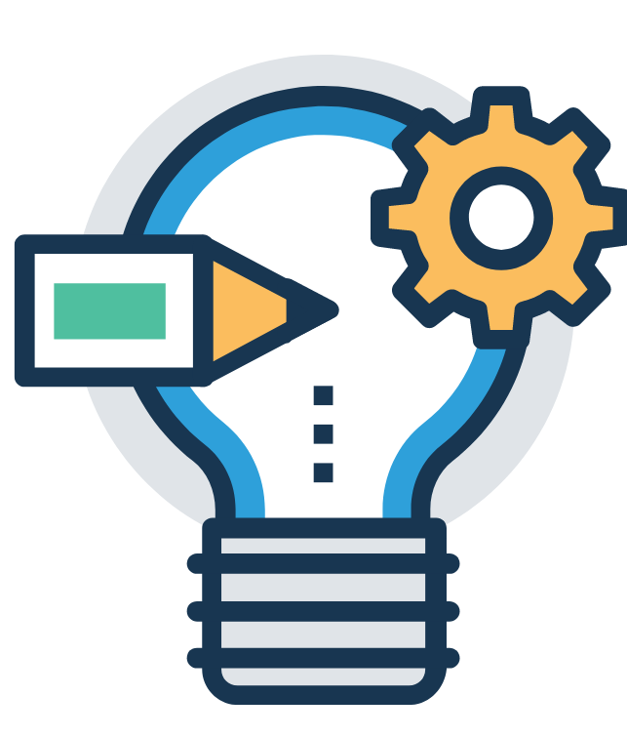



Year 6 newsletter—Spring 2
Journeying together with God
Science
In Science, we will explore living things and their habitats, learning how scientists classify the natural world. We will focus on Carl Linnaeus, his contribution to our understanding, and how organisms are grouped by shared characteristics.
RE
People of God
How can following God bring freedom and justice?
Children will explore Moses, freedom from slavery in the Exodus and the Ten Commandments, considering how Christians understand freedom, justice and care for others.
PSHE
Feeling good and being me.
Children will learn to treat themselves and others with compassion, using positive self-talk to support wellbeing. They will challenge stereotypes and practise how to respond safely and seek help in an emergency.
Art
Painting and mixed media
In this unit, children will explore how artists use painting to tell stories, express ideas and communicate messages. They will analyse figurative and abstract artwork, considering composition, colour and meaning, before experimenting with techniques in their sketchbooks. Pupils will research an artist, plan and refine their ideas, then create an independent final piece using materials chosen for a particular effect.
Geography
In our “Why does population change?” unit, children will investigate global population distribution and the reasons populations grow or decline. They will explore birth and death rates, migration and climate change, then use local fieldwork to consider environmental impacts.
PE
The topics for our PE sessions this half term include:
Athletics on Tuesdays with Mrs Bell and Mrs Akhondi.
Invasion games on Wednesday with Miss Gatehouse and Mrs McHugh.
Home Learning
Homework is handed out on a Friday and collected in on the following Monday. Please ensure that homework is completed and well-presented.
It is encouraged that children regularly access Spelling Shed and TTRS and read regularly at home to.
communication
Please note that we will be moving to Arbor for communication over the next half term.
Also, don’t forget to visit our Facebook, Twitter and class webpage to see all our learning in Y6 and school.
Nurture
Discover
Respect

